Slide 1
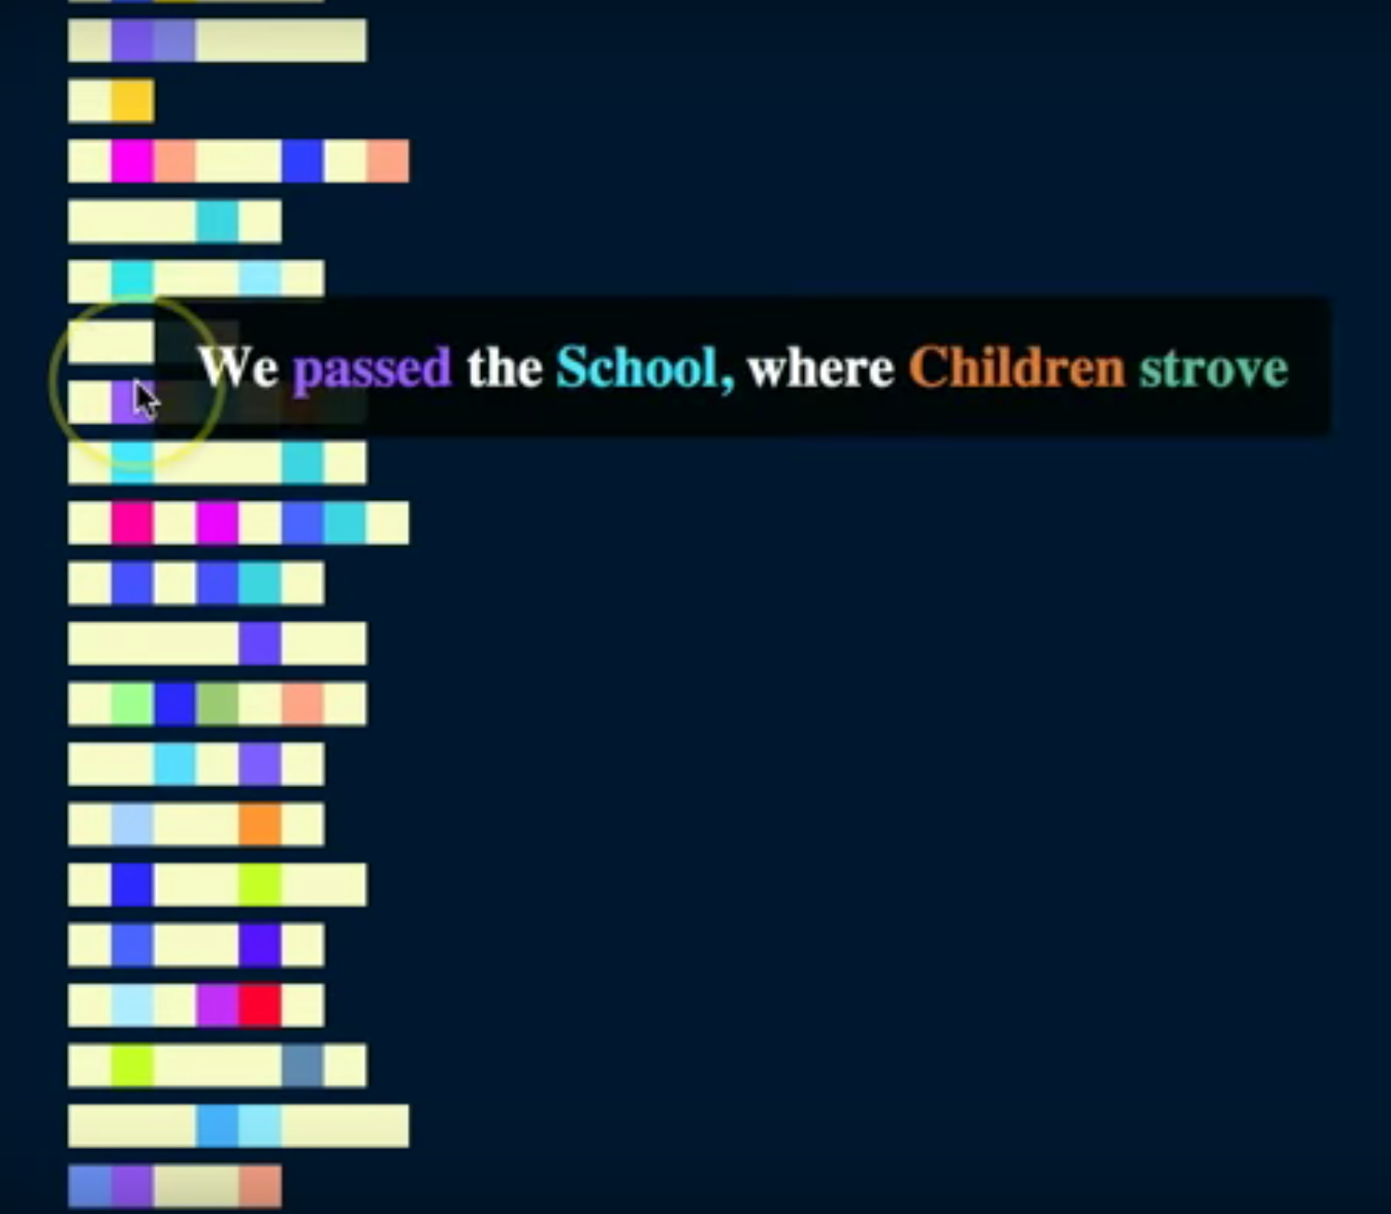






How to Close Read a Topic Model
A Topic Words in Context talk
by Jonathan Armoza
: @jonathangrams
: github.com/jarmoza

Slide 2
Why do we use topic models?

Slide 3
What is it you are interested in studying?
- Cultural objects
- People and their behaviors
- Historical trends
- Unseen patterning

Slide 4
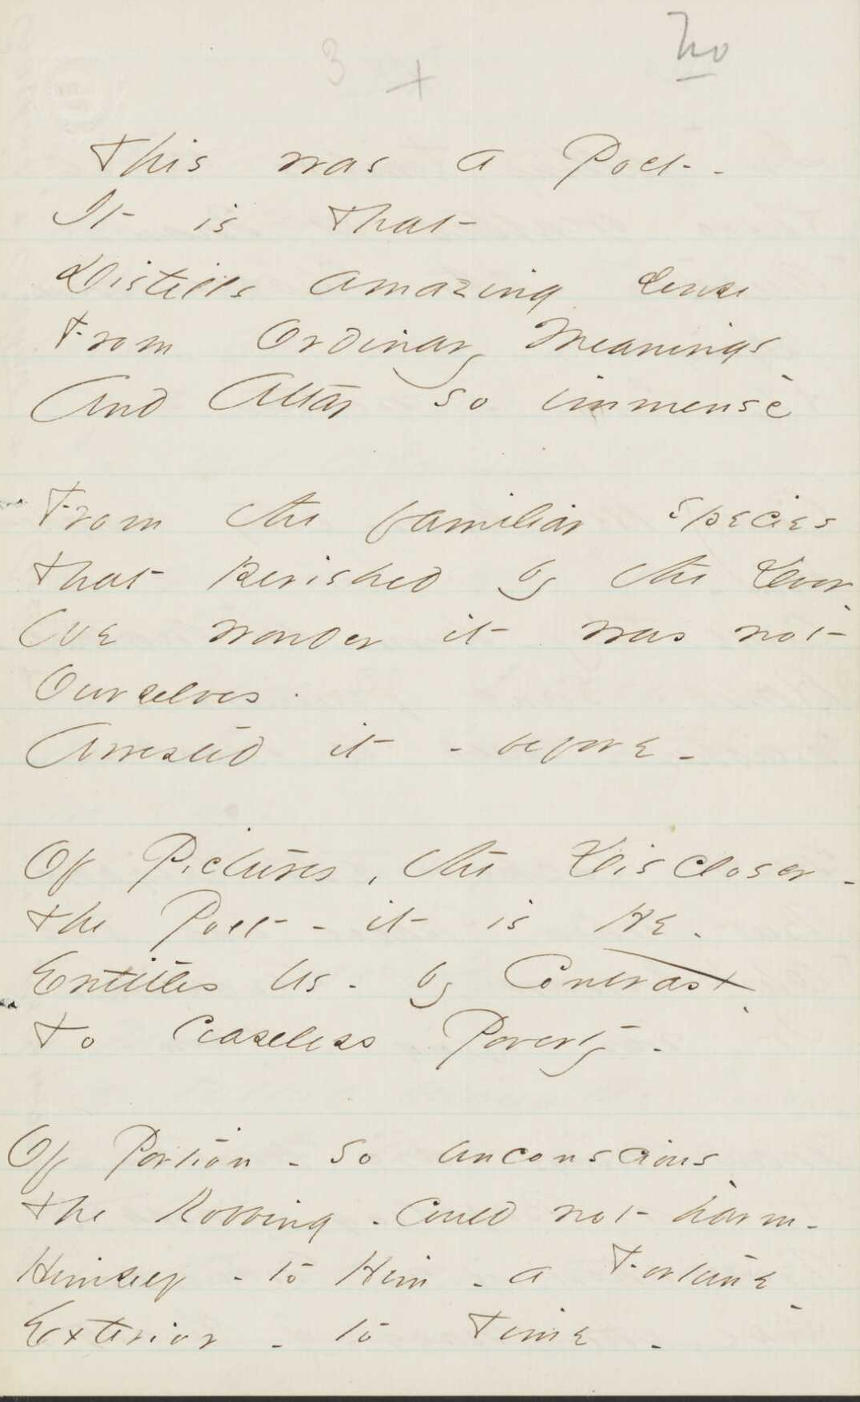
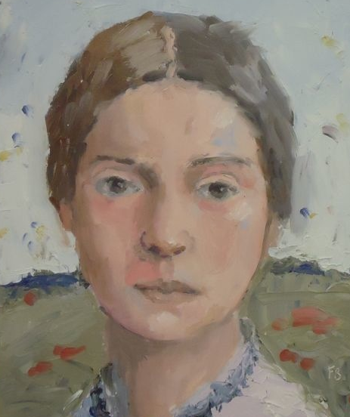
Emily Dickinson and her Fascicles
b. 1830, d. 1886
authored ~1800 “poems”
copied & sewed 811 of them into 40 manuscript books
others were stacked in 15 sets

Slide 5
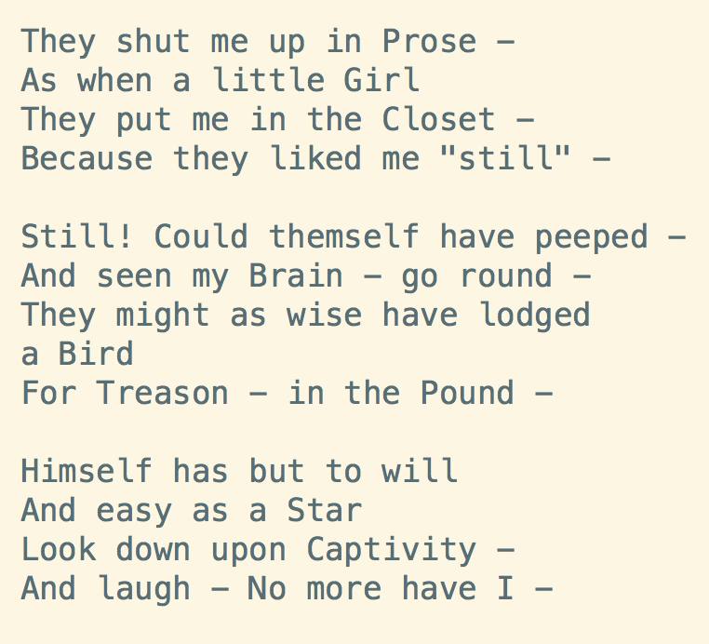
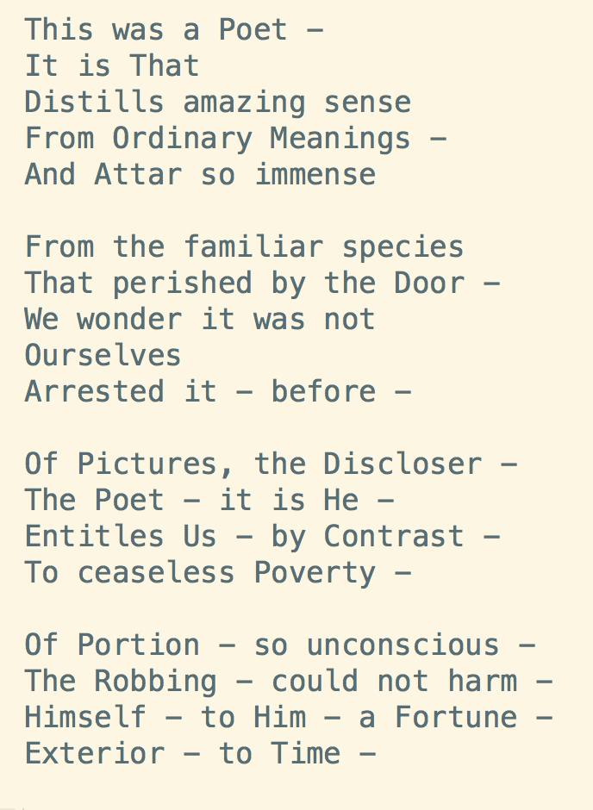
6th and 7th poem from Dickinson’s 21st Fascicle

Slide 6
How can humanities scholars use complex/big data models of their objects of study?
A Few Suggestions
(1) A model is not just a representation of many things but also a one that characterizes the relationships of our objects of study.
(2) Considering such relationships when working with mathematical models of humanities data is key to returning to a context where the individual objects of inquiry hold our attention.

Slide 7
Well, what is a topic model?
Let’s think about this for a moment.

Slide 8
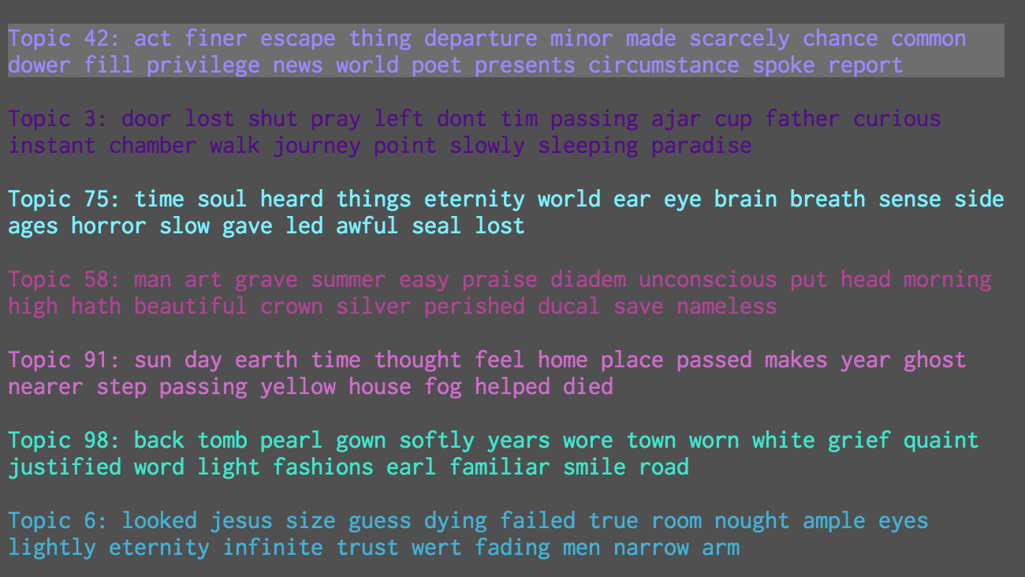
Corpus Topic Word Lists

Slide 9
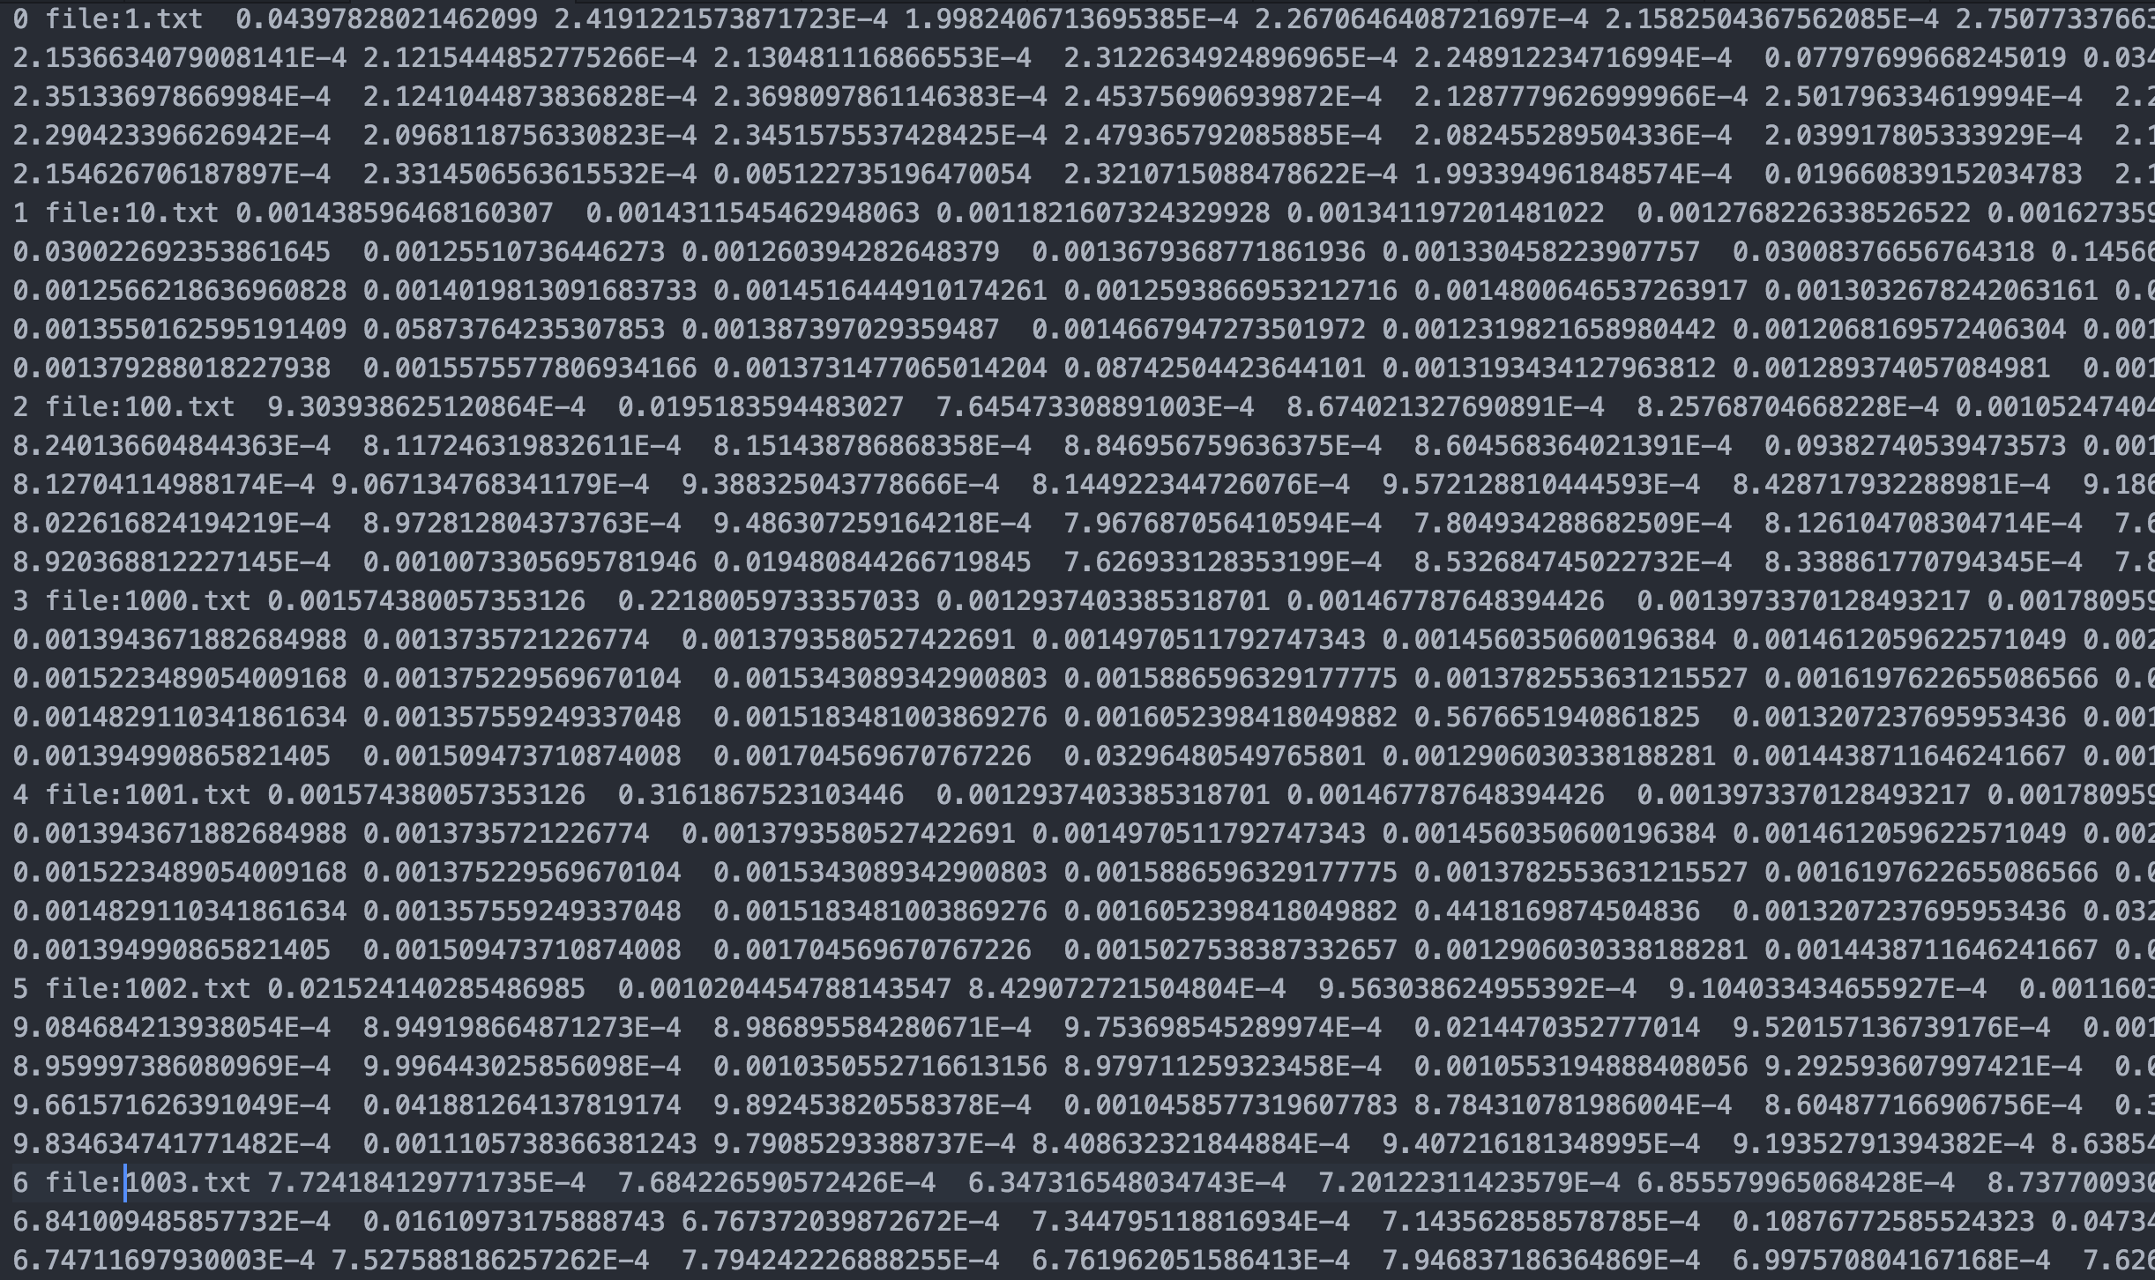
file:1.txt
Document Topic Weights
file:2.txt
file:3.txt
file:4.txt
file:5.txt
file:6.txt

Slide 10
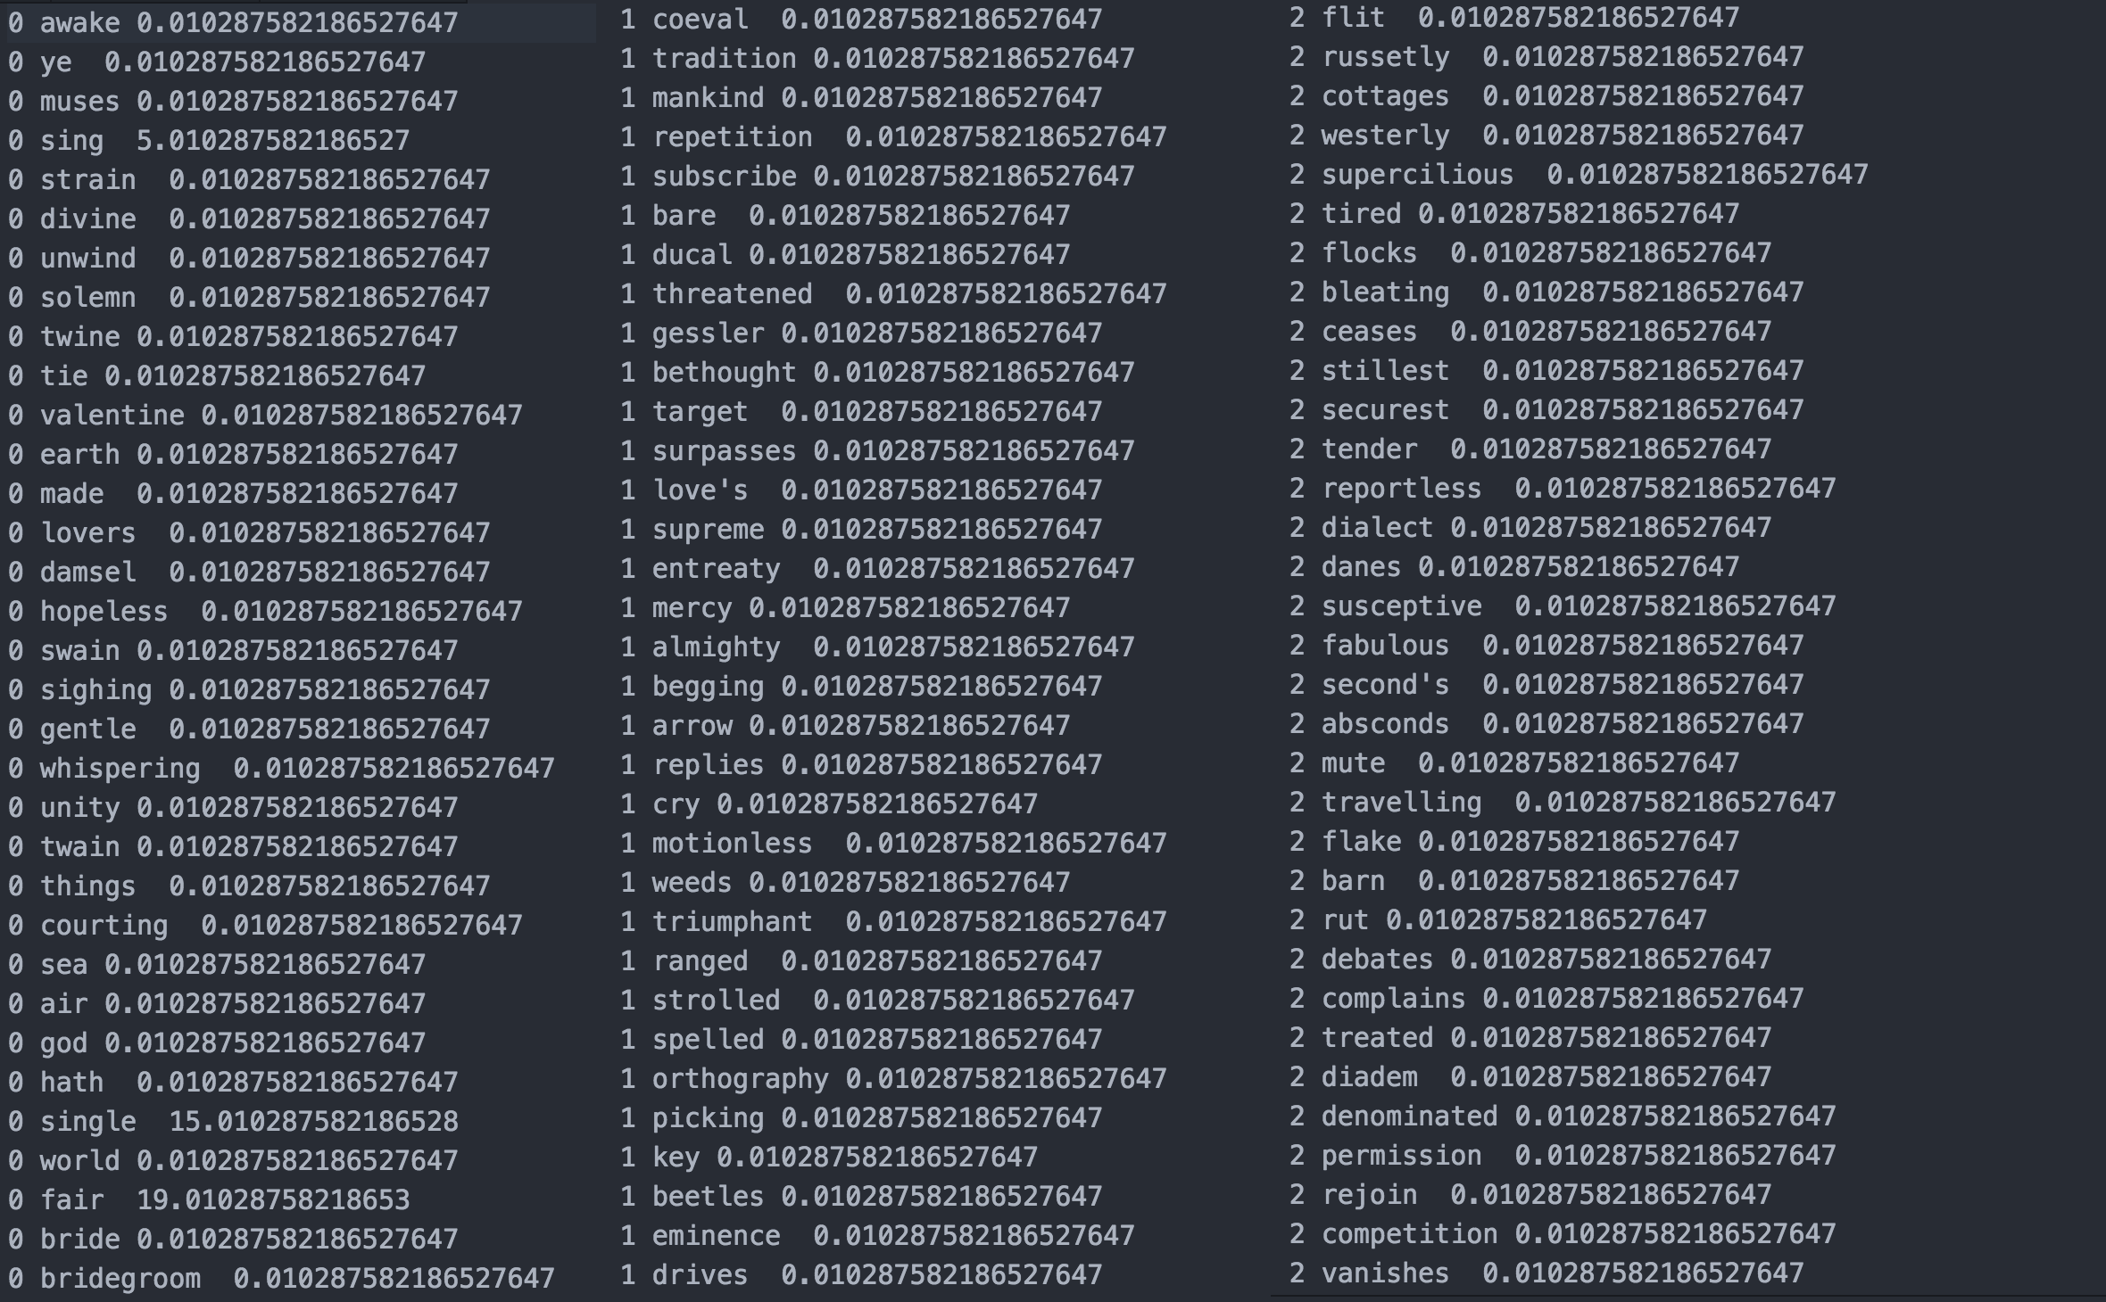
Topic Word Weights

Slide 11
Contexts, Statistical- and Object-Oriented
We can see patterns from up high
What is the topic composition of a document? Of a corpus?
How are documents similar based on topic composition?
Which are the most highly weighted topics?
But...we can also see patterns down low
What are the topic words of a document?
Which are their word weights?
Which words are shared across documents?

Slide 12
Relationships (across Ontologies)
What are the relationships between and among documents and clusters and statistical distributions?
Relationships between these entities stretch across hierarchical contexts or frames of reference within the model and within the cultural object/corpus.
These are mixed ontologies for our consideration and analysis.
Or, a similar question: “How do we span this ontological divide?”

Slide 13
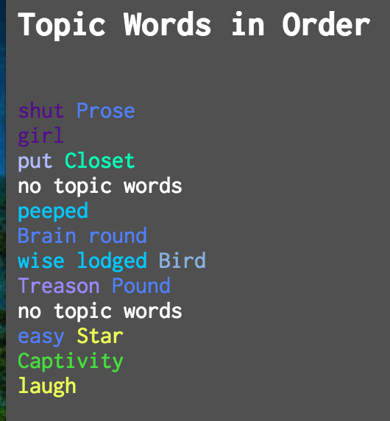
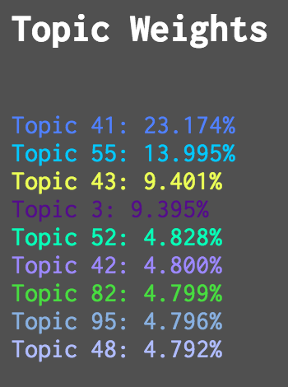
What about texts?
Each document has a set of predominant topic weights
This reflects the individual text as well as the whole modeled collection

Slide 14
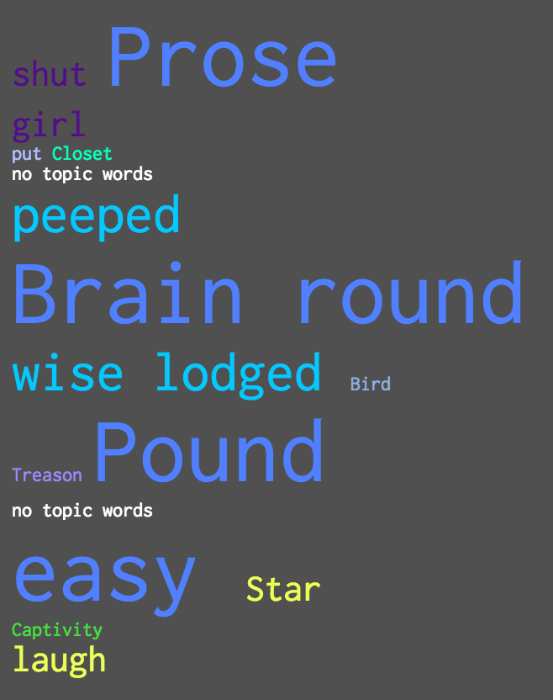
Words sized by document-topic weight

Slide 15
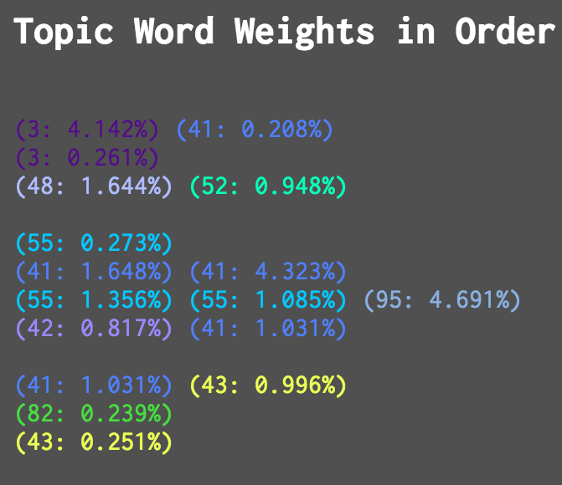
What about words?
Topic words also have their own weights within topics
(Thus the top 20 word lists we are used to seeing)

Slide 16
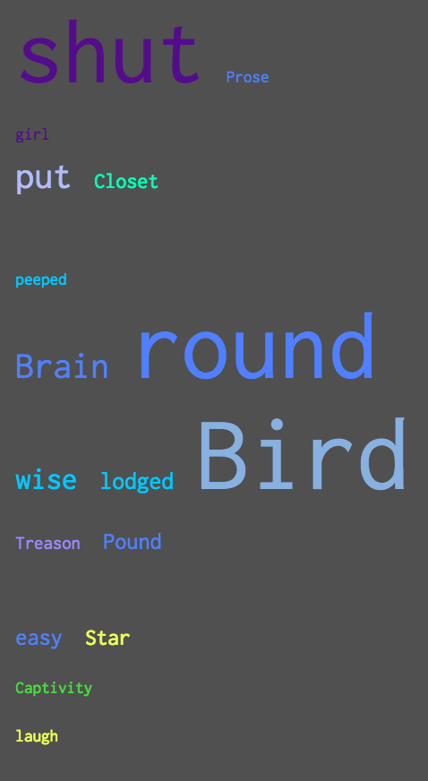
Words sized by topic word weight

Slide 17
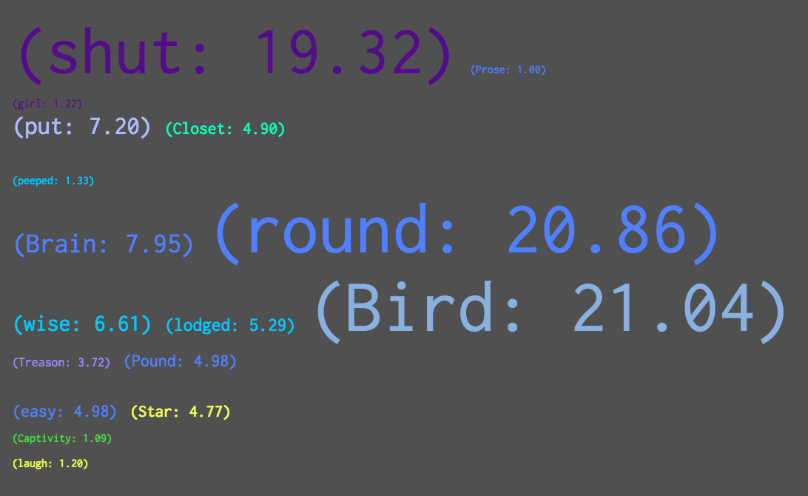
Combining topic and word weights

Slide 18


Topic Words in Context (or TWiC)
github.com/jarmoza/twic

Slide 19
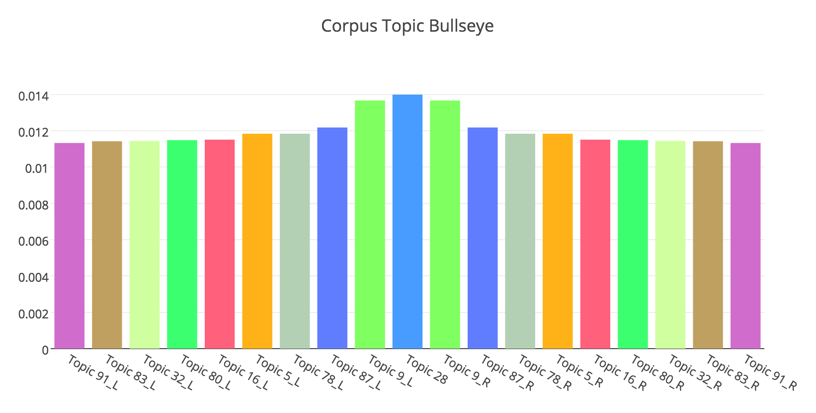
What are we looking at?

Slide 20
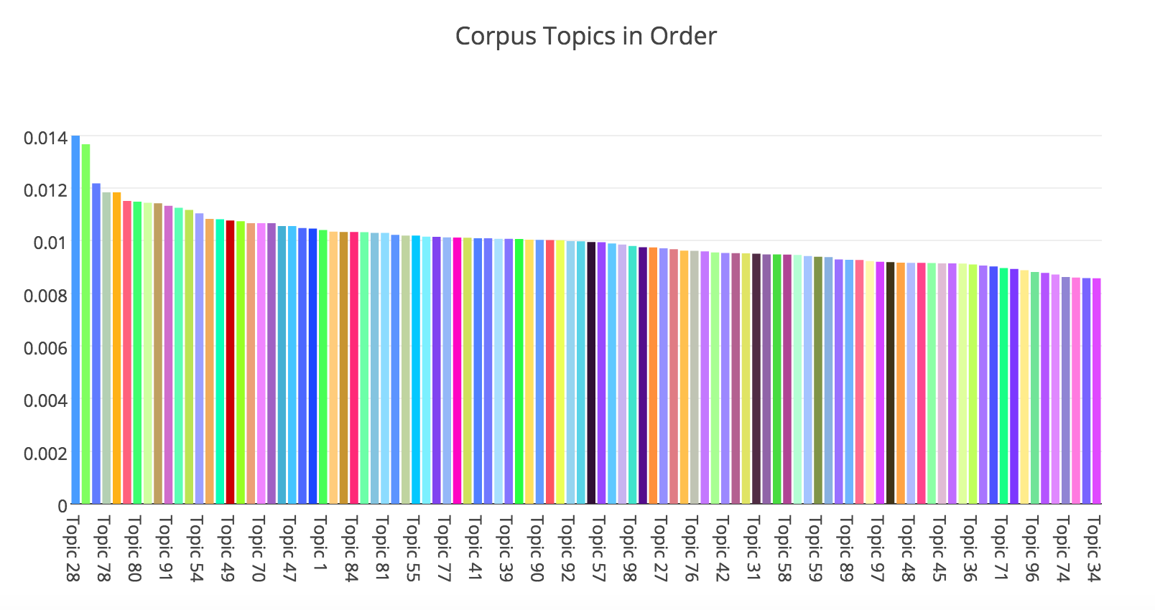

Slide 21
<Video of TWiC here...removed for Github size limits. See https://github.com/jarmoza/twic/blob/master/README.md for images>

Slide 22
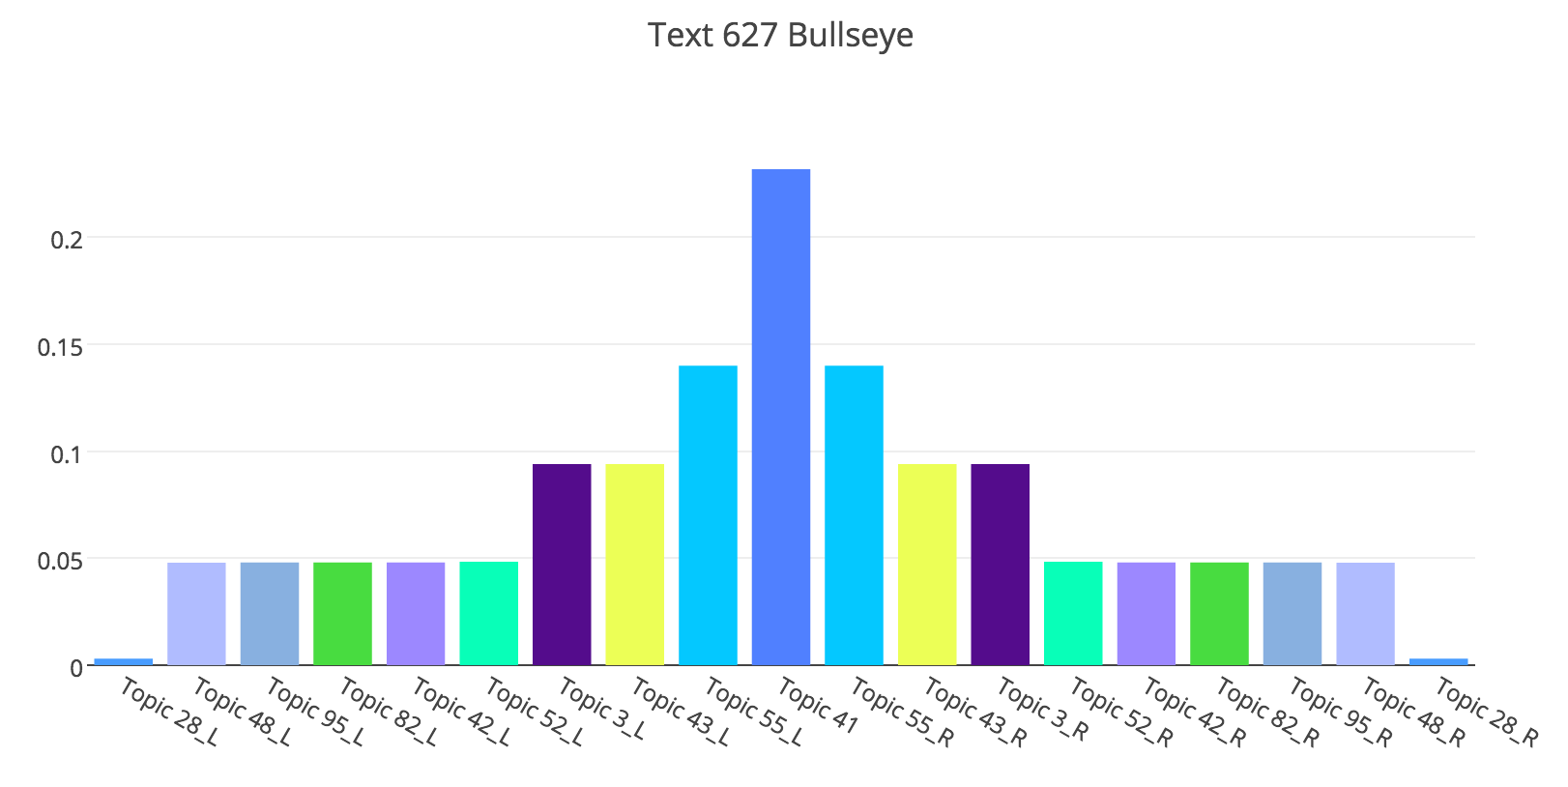
The Topics of “They Shut me up in Prose”

Slide 23
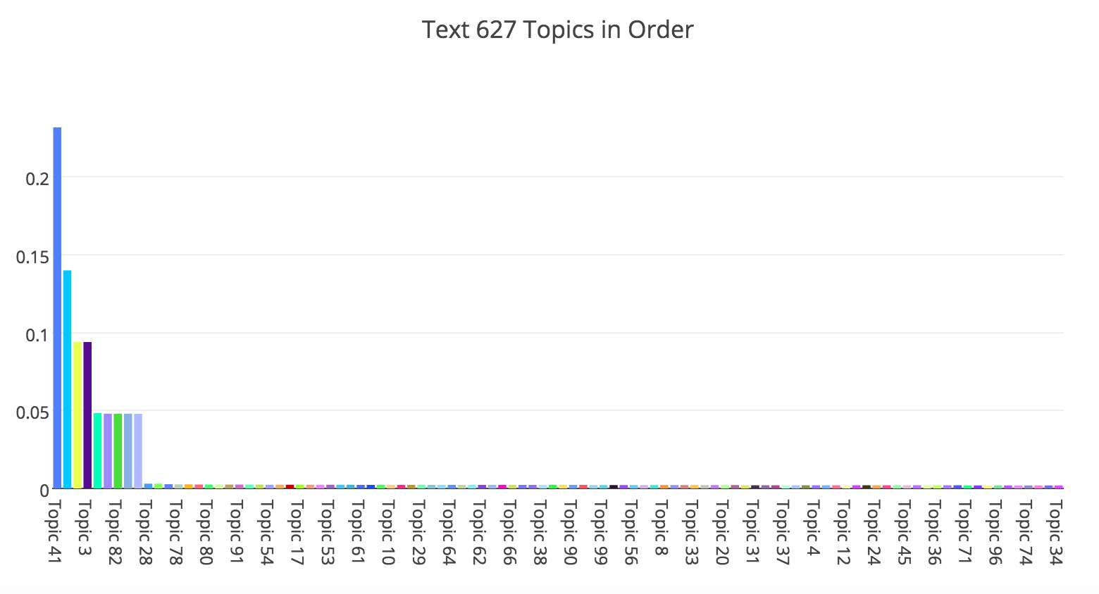
Dramatic falloff in distribution weights at the cluster, individual, and topic levels of the model

Slide 24
Topic Models can (also) be Sharply-Defined at the Document Level
This tells us...
Especially when we consider:
Document-topic weights
Topic word weights
Composite rankings

Slide 25
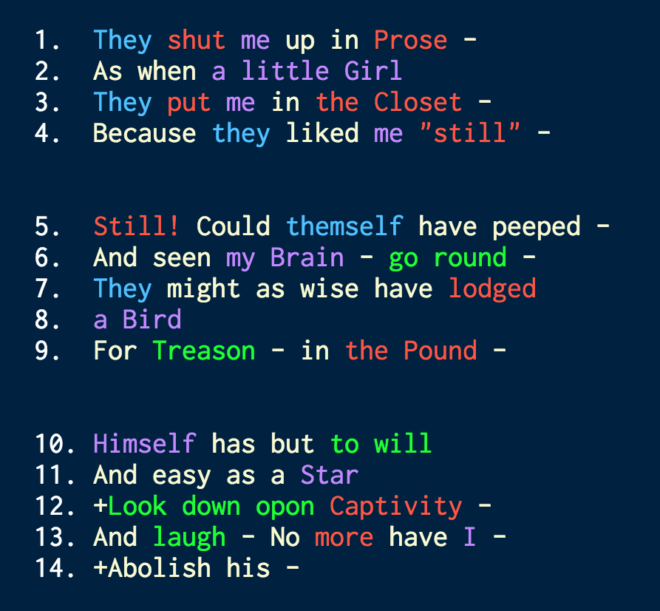
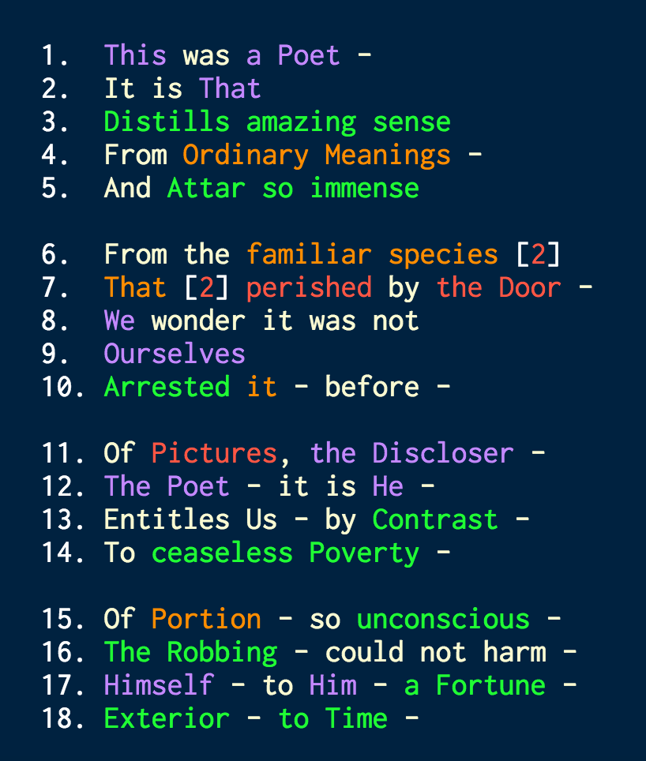
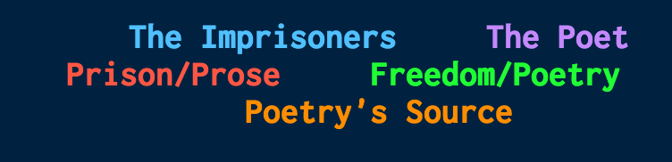
Eleanor Heginbotham on the 21st Fascicle

Slide 26
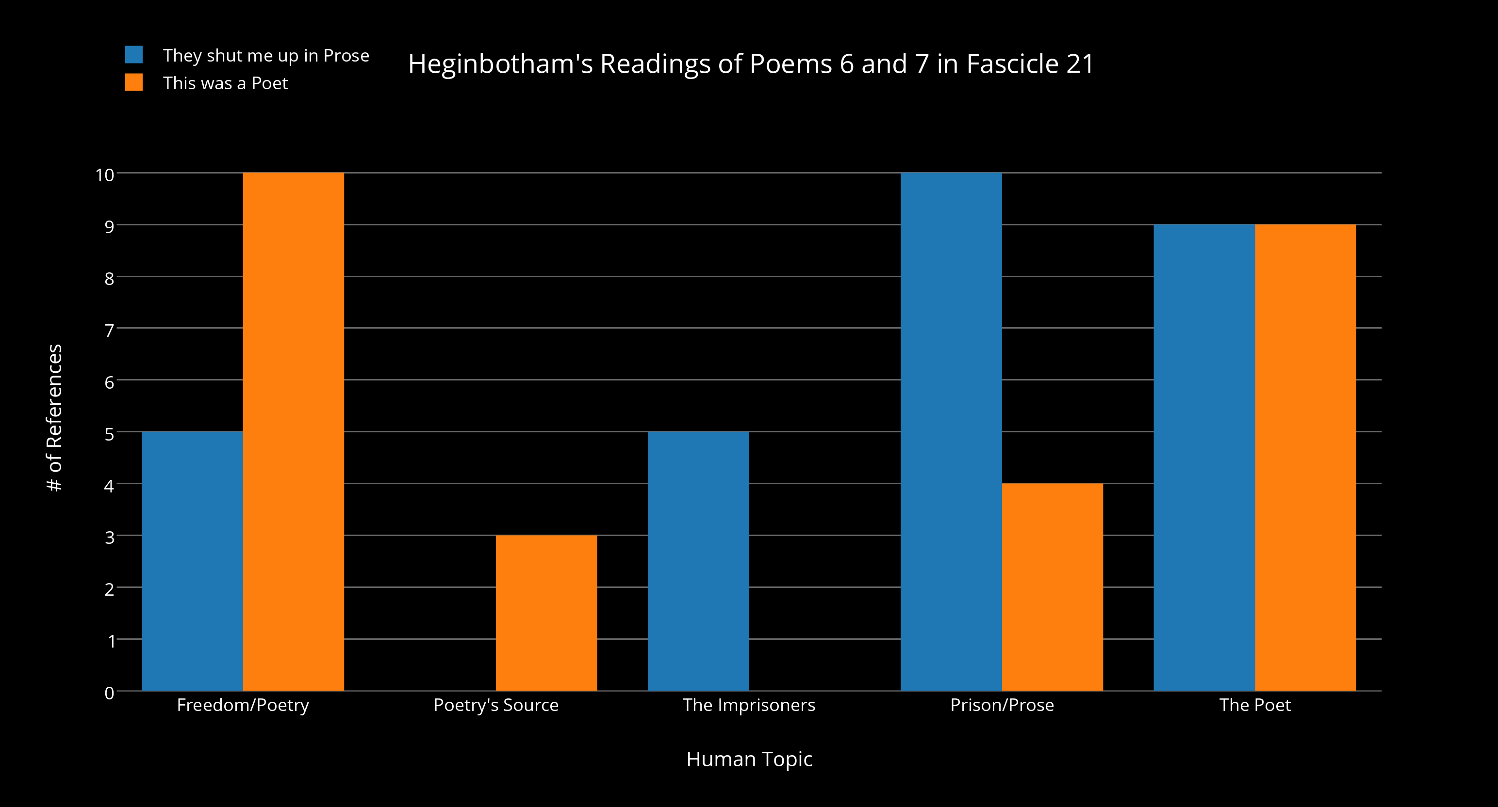
Counting Presences of Heginbotham’s Topics

Slide 27
So what about human-authored orderings in topic models?

Slide 28
<Video of TWiC publication view here...removed for Github size limits. See https://github.com/jarmoza/twic/blob/master/README.md for images>

Slide 29
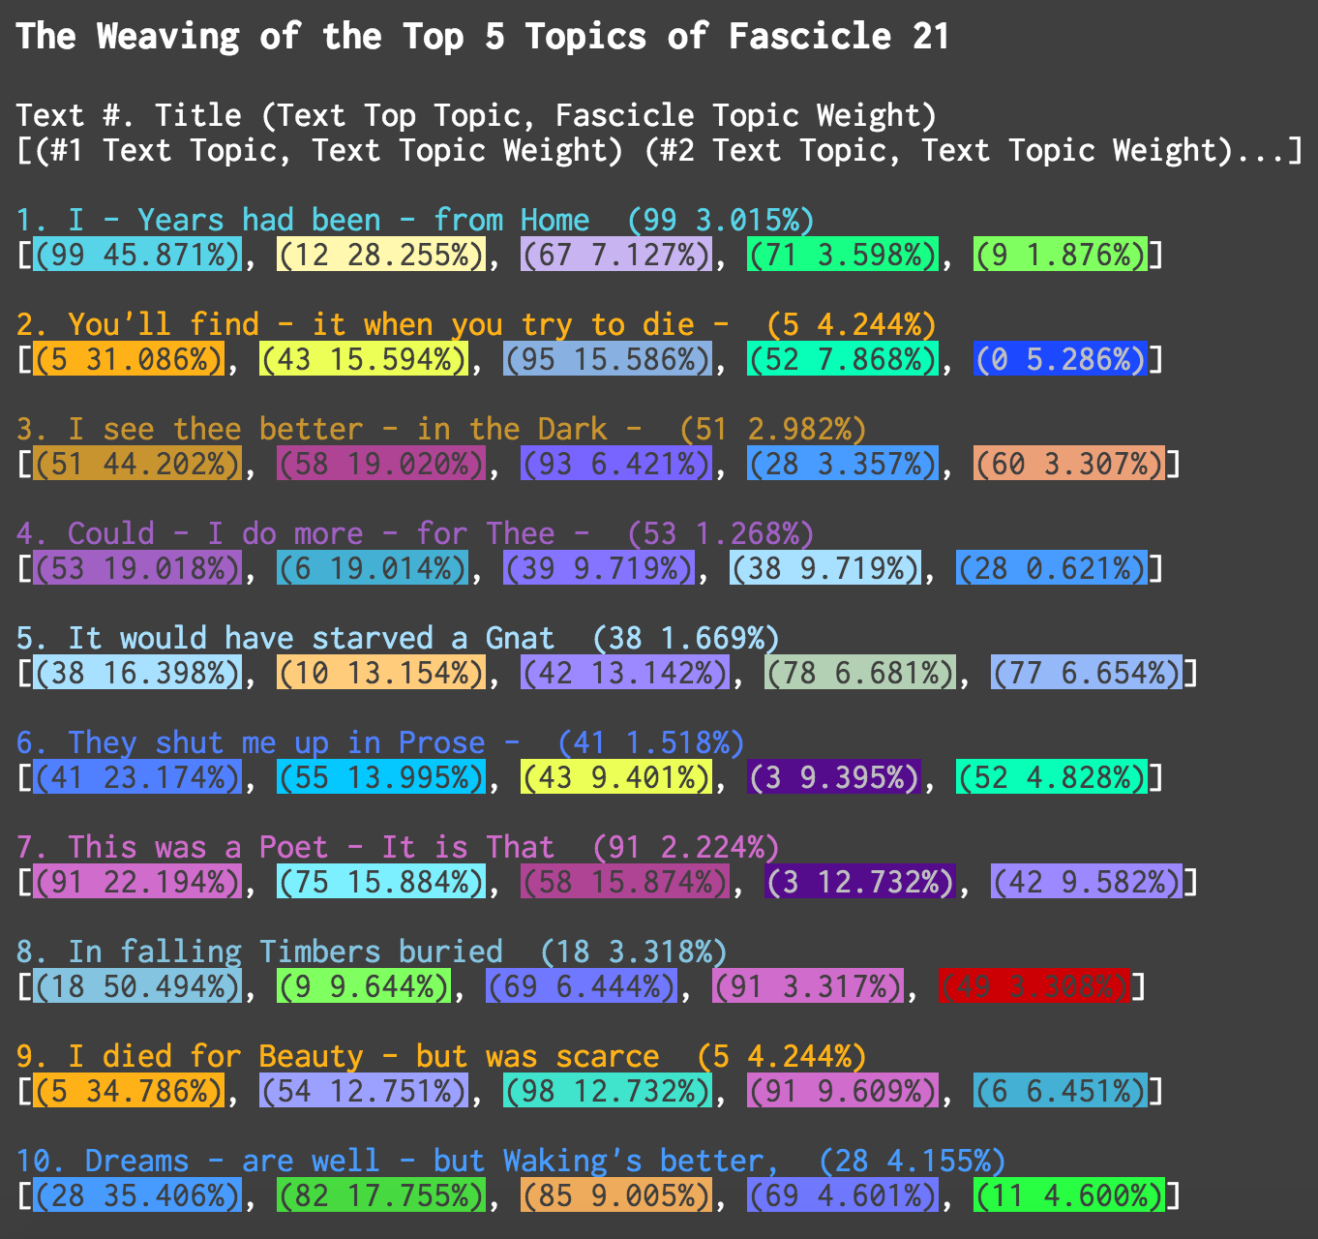
The Dynamics of Topics in
Human-Authored Orderings

Slide 30
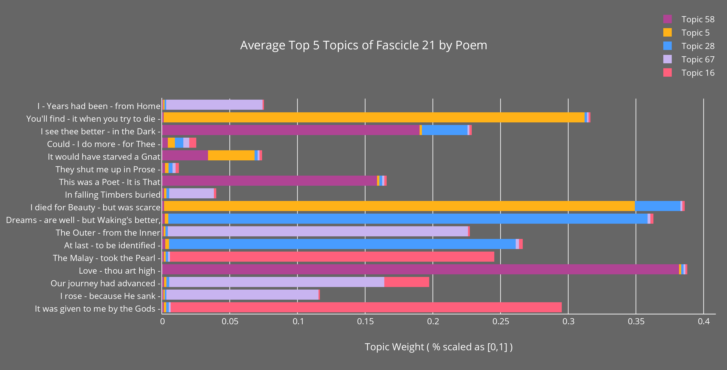
Average topics across a publication

Slide 31
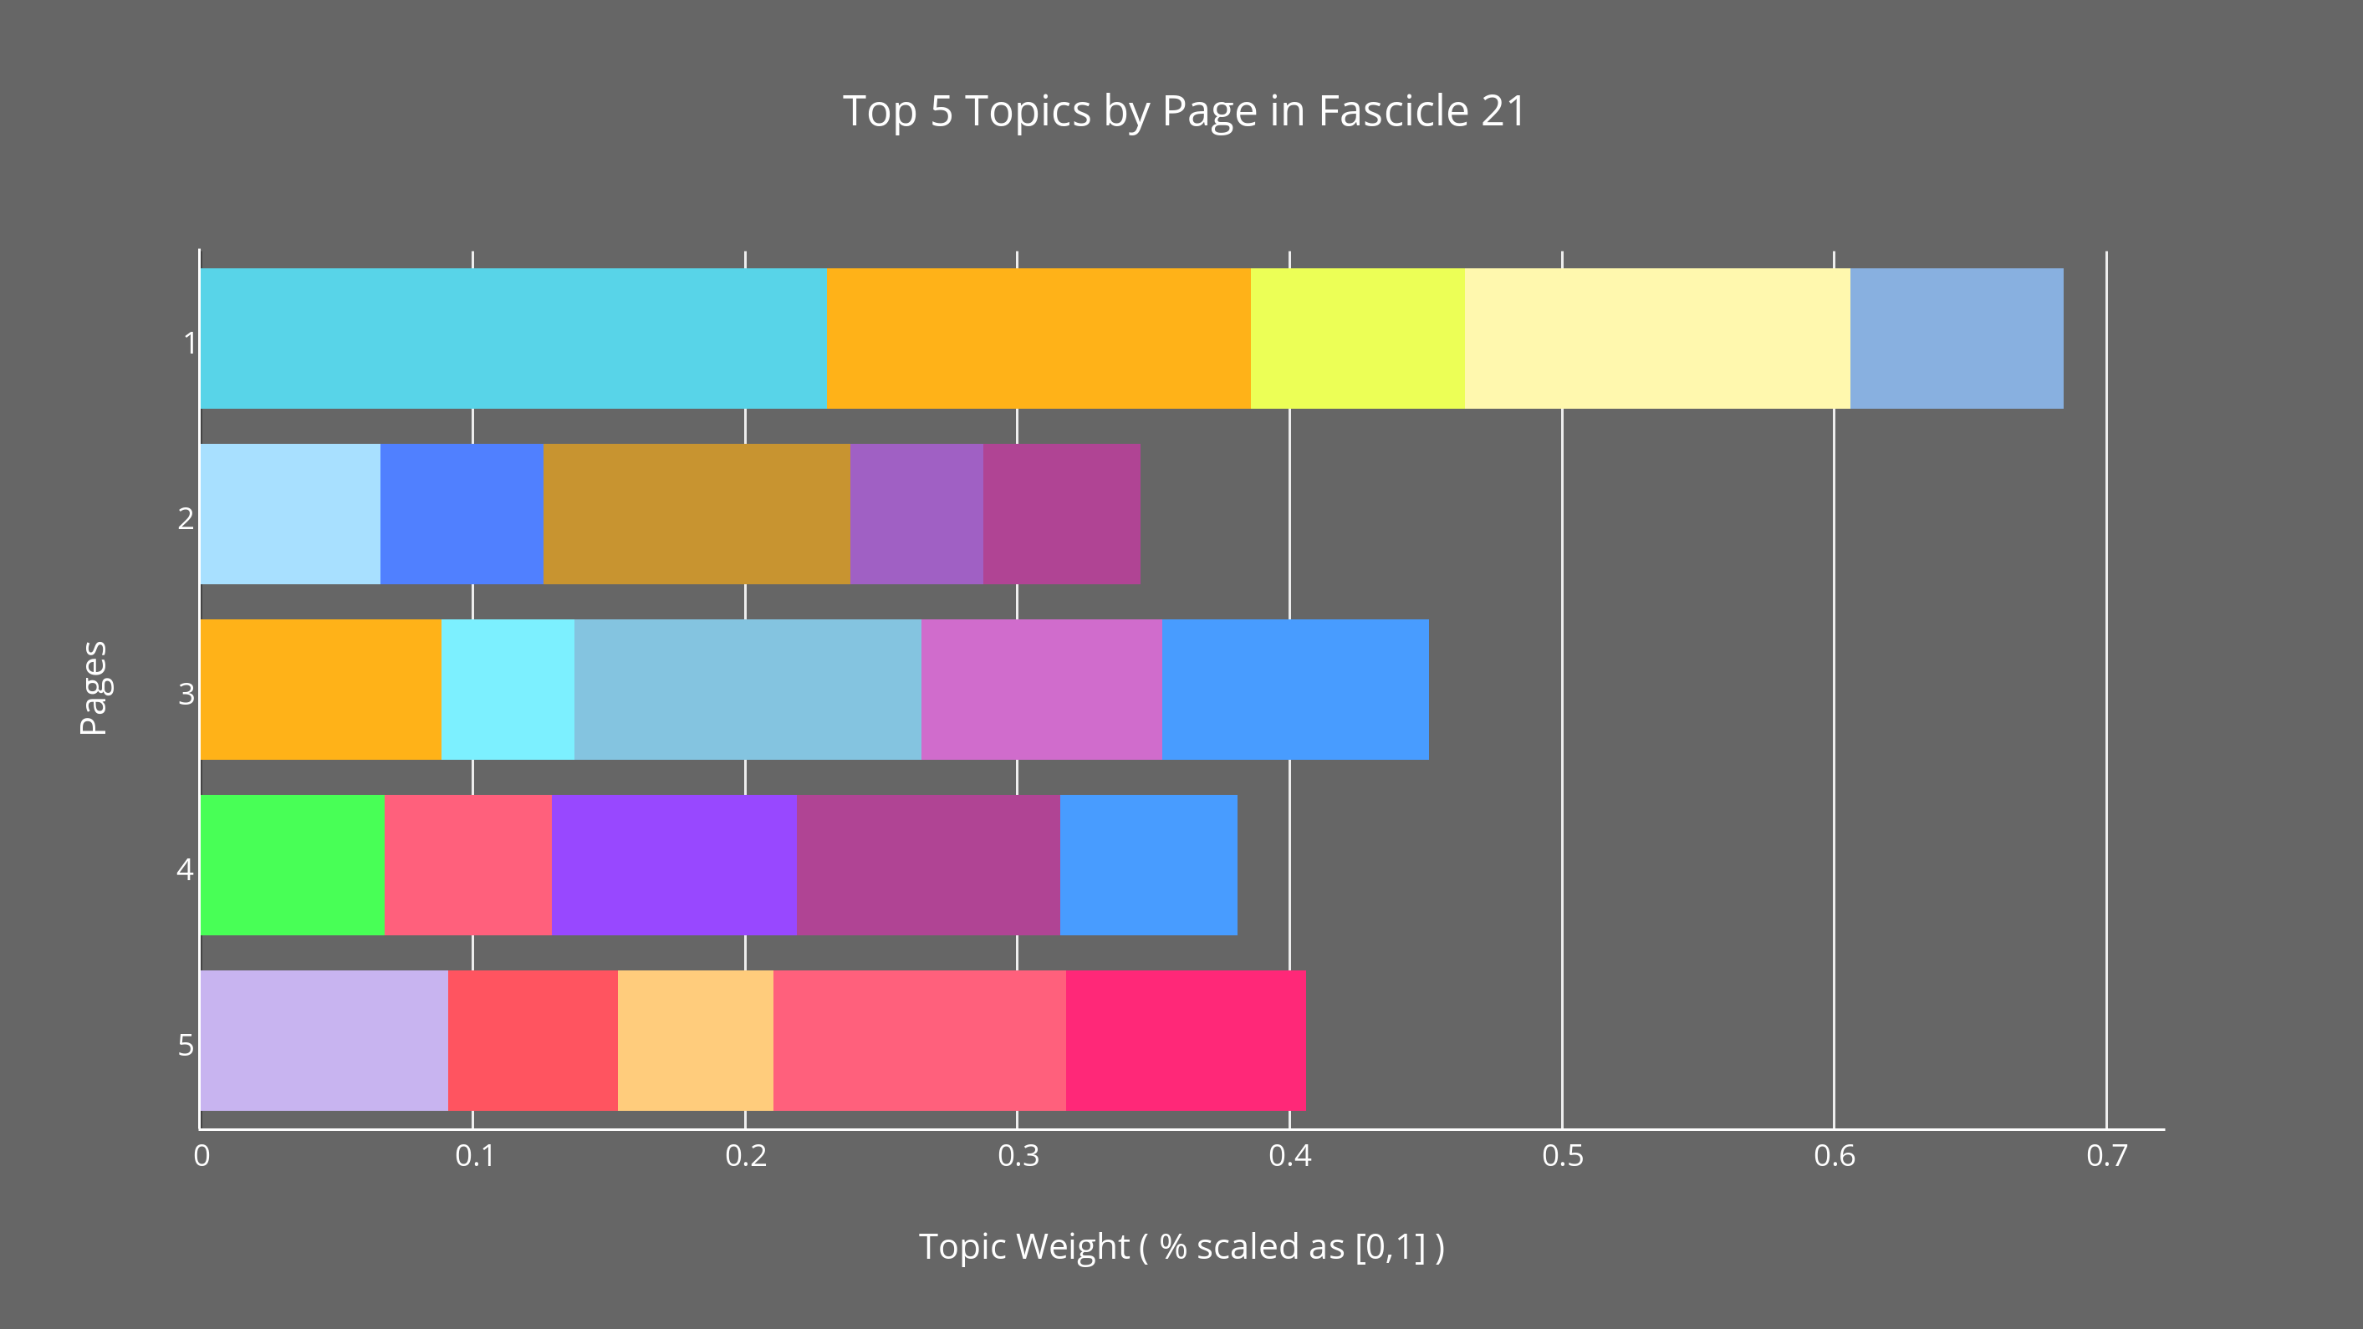
Topics across physical pages

Slide 32
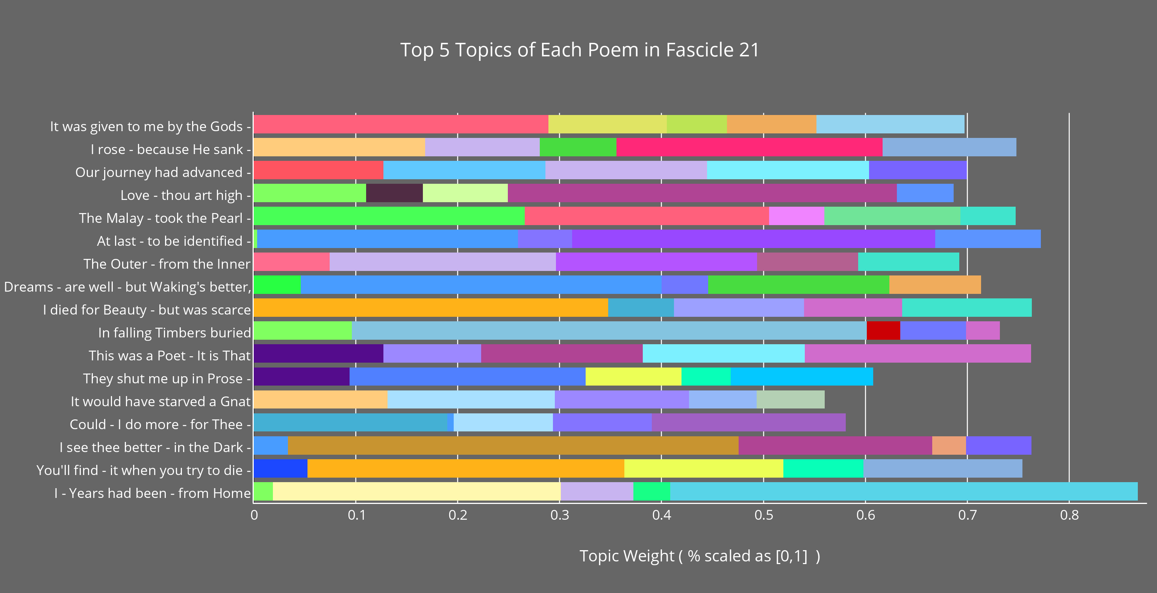
Topics across individual works

Slide 33
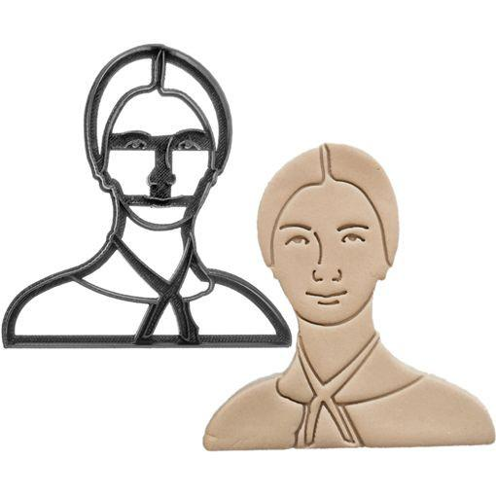
So, How to Close Read a Topic Model?
We have already been doing this at several levels of the model.
But there remains one more level in the model that has yet to be addressed: the document level, that is, the words of an individual text.

Slide 34
Cookie Cutter and Lens
They shut me up in Prose –
As when a little Girl
They put me in the Closet –
Because they liked me “still” –
Still! Could themself have peeped –
And seen my Brain – go round –
They might as wise have lodged
a Bird
For Treason – in the Pound –
Himself has but to will
And easy as a Star
Look down opon Captivity –
And laugh – No more have I –
They shut me up in Prose –
As when a little Girl
They put me in the Closet –
Because they liked me “still” –
Still! Could themself have peeped –
And seen my Brain – go round –
They might as wise have lodged
a Bird
For Treason – in the Pound –
Himself has but to will
And easy as a Star
Look down opon Captivity –
And laugh – No more have I –

Slide 35
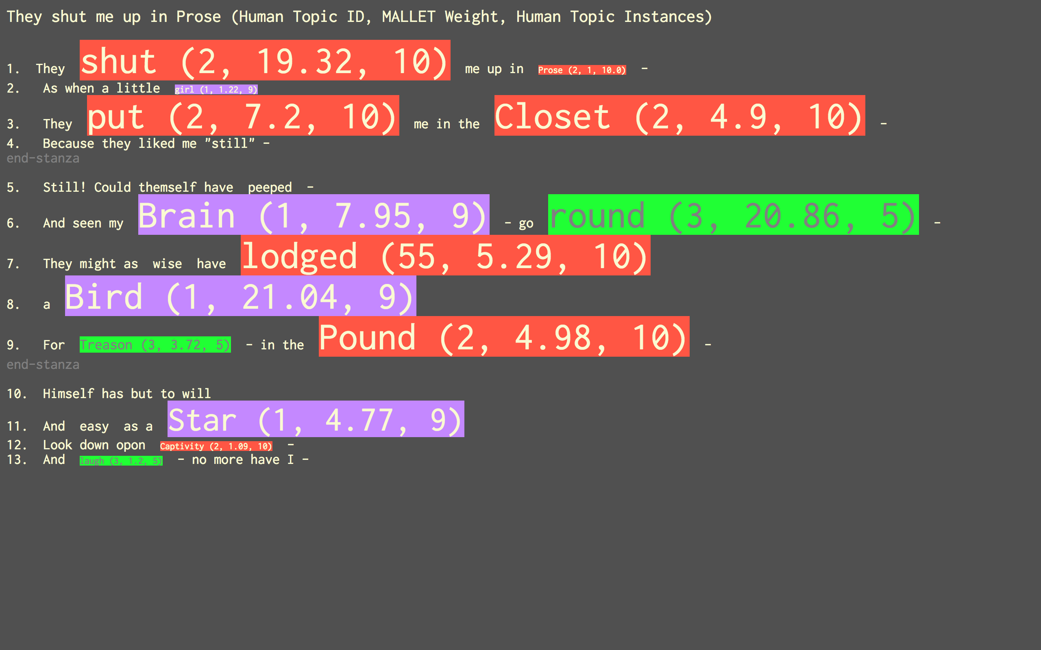
Heginbotham’s Lens of a Topic Model

Slide 36
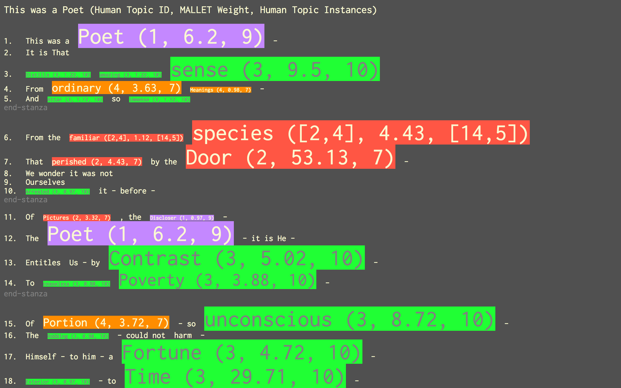

Slide 37
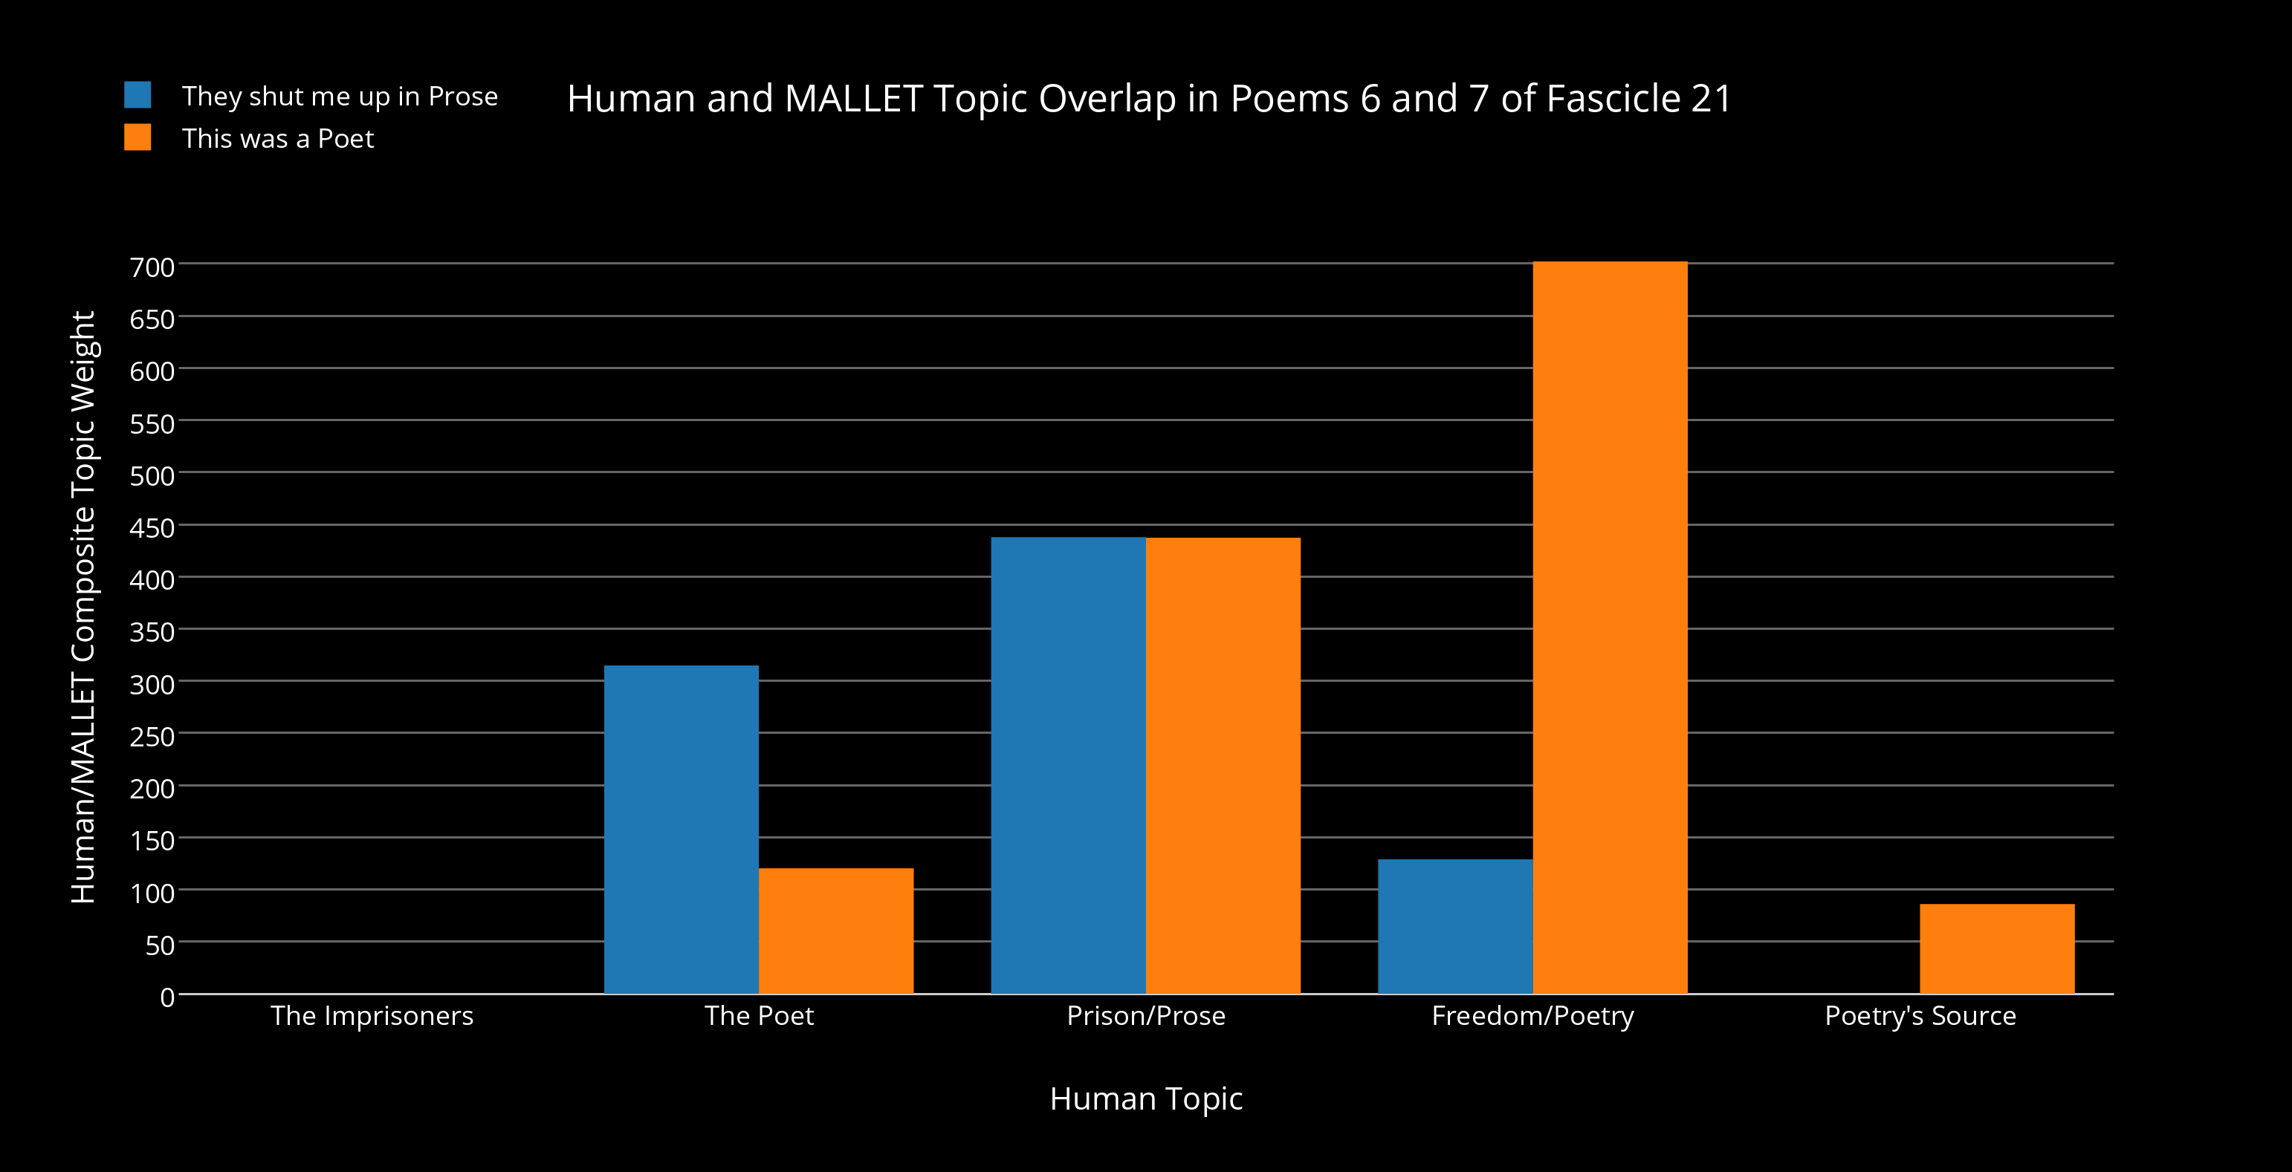
New Dynamics Emerge in Composite Model Weighting

Slide 38
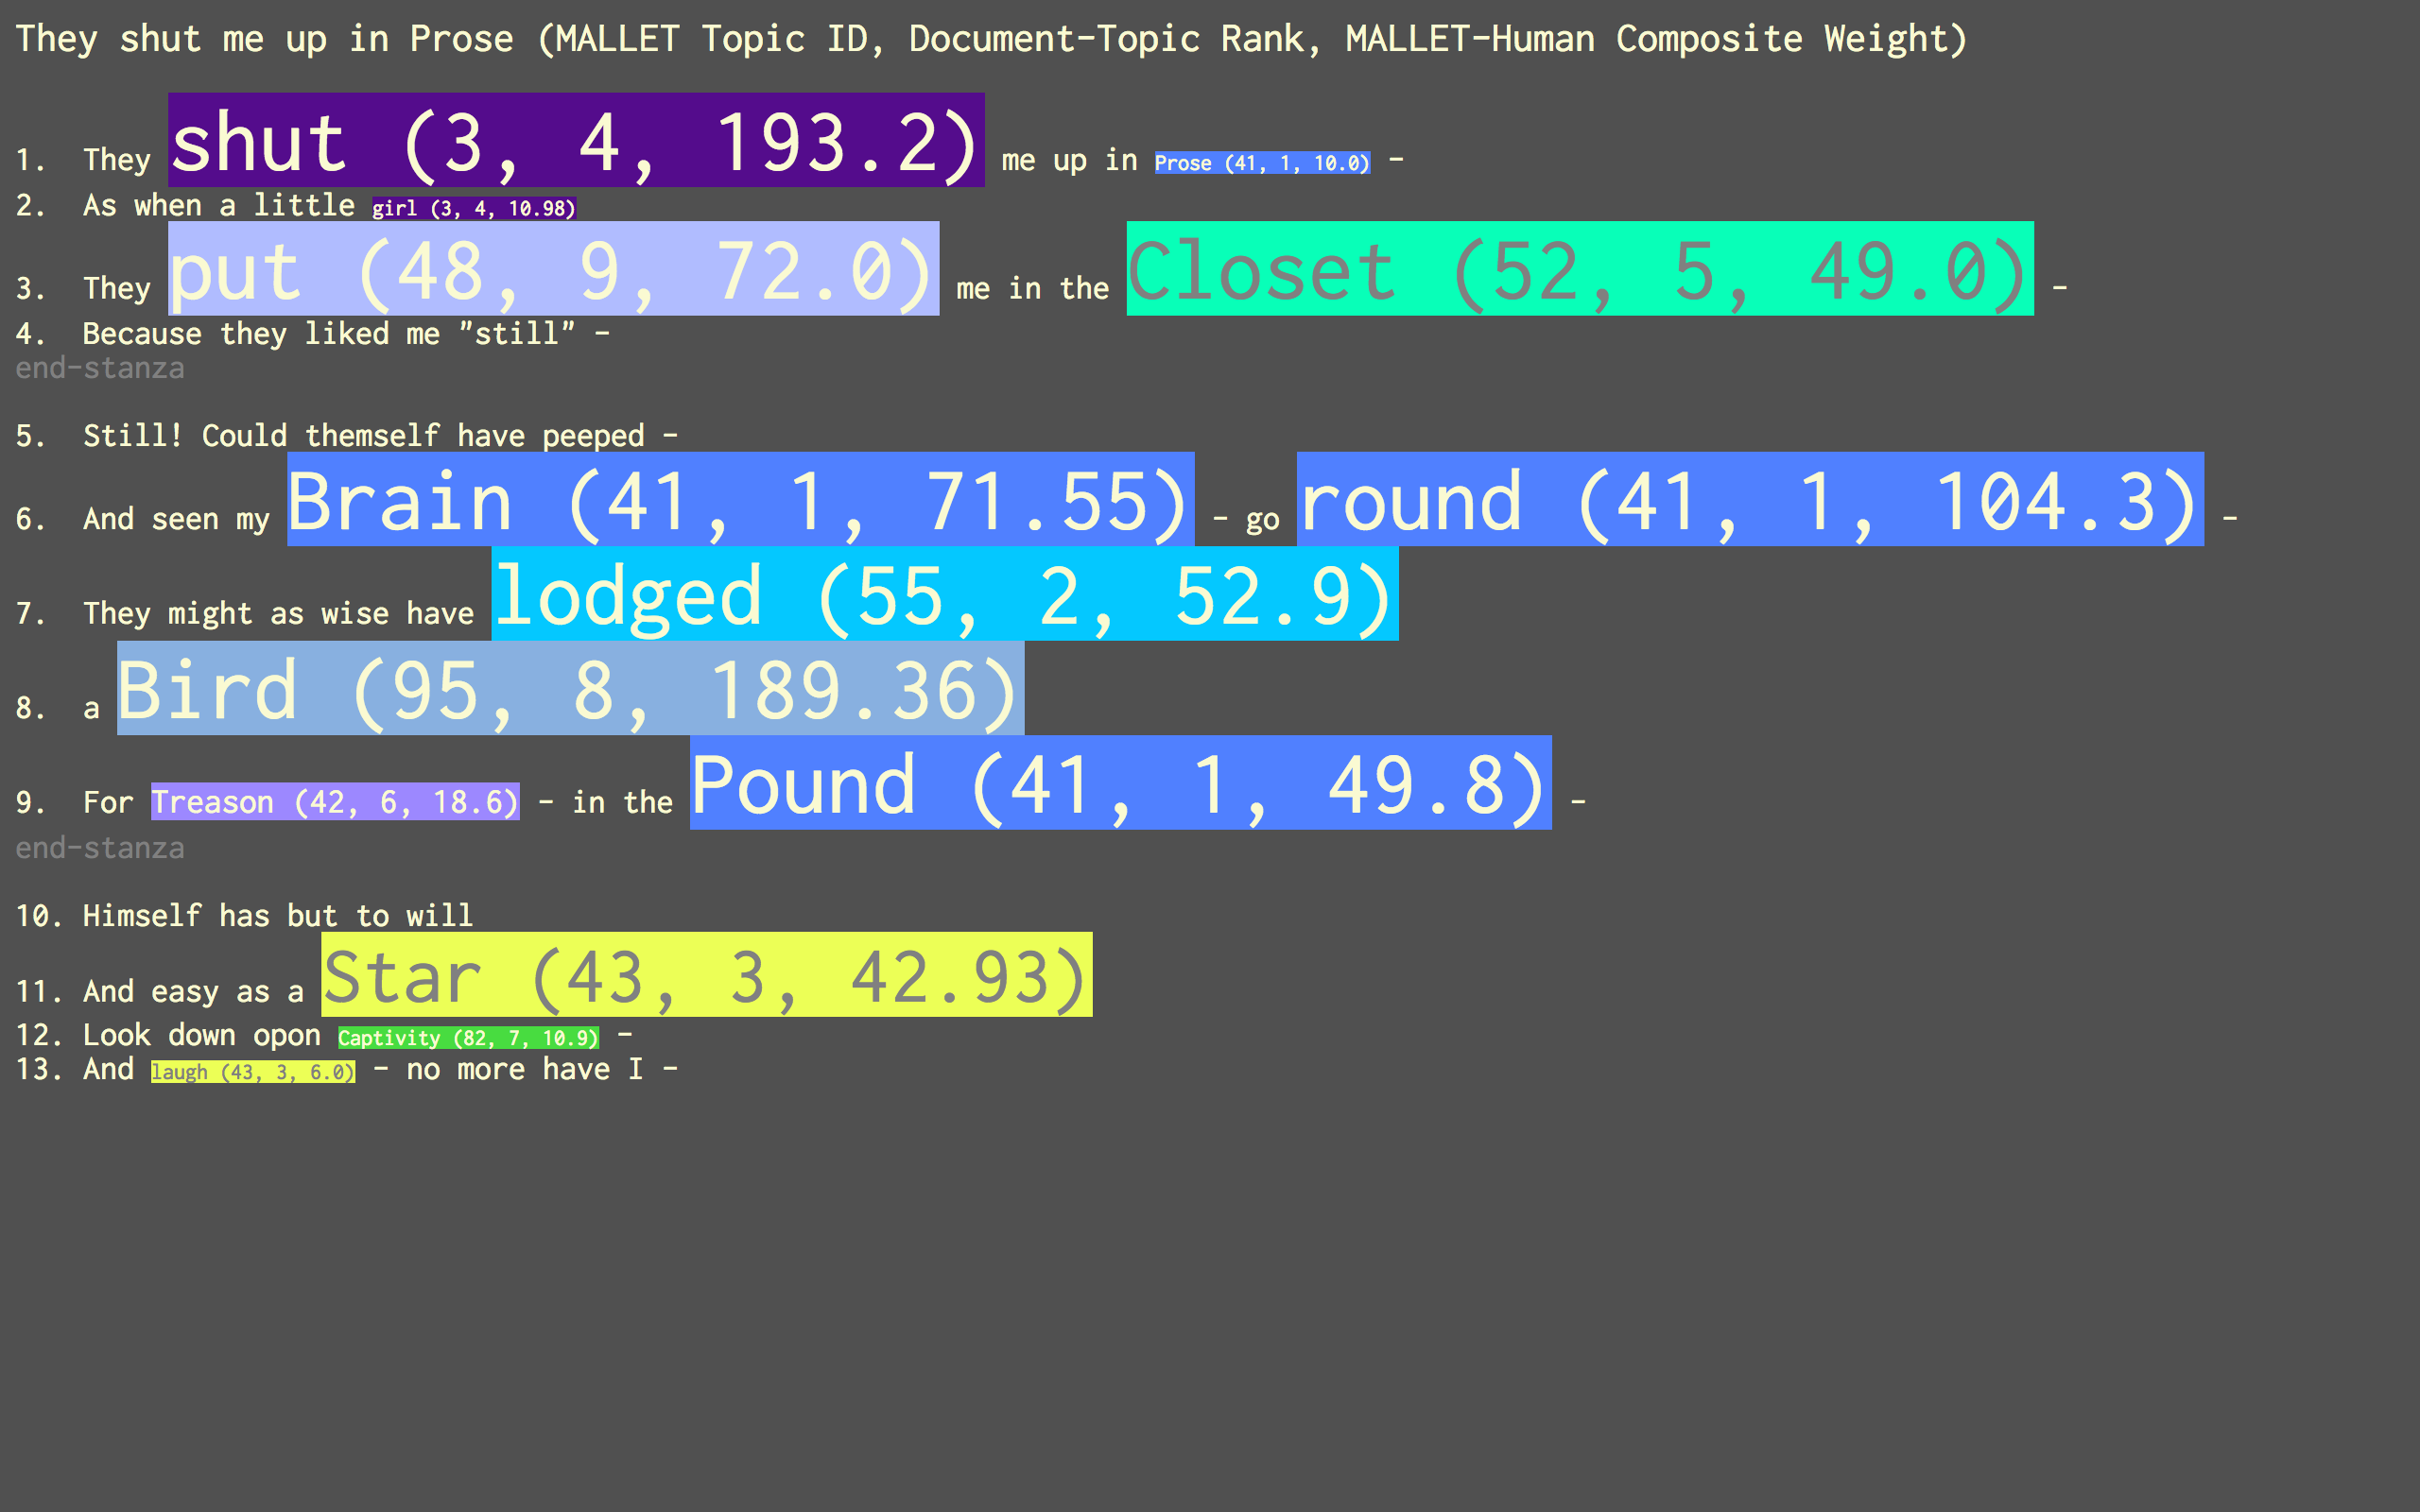
MALLET’s Lens of a Human Model

Slide 39
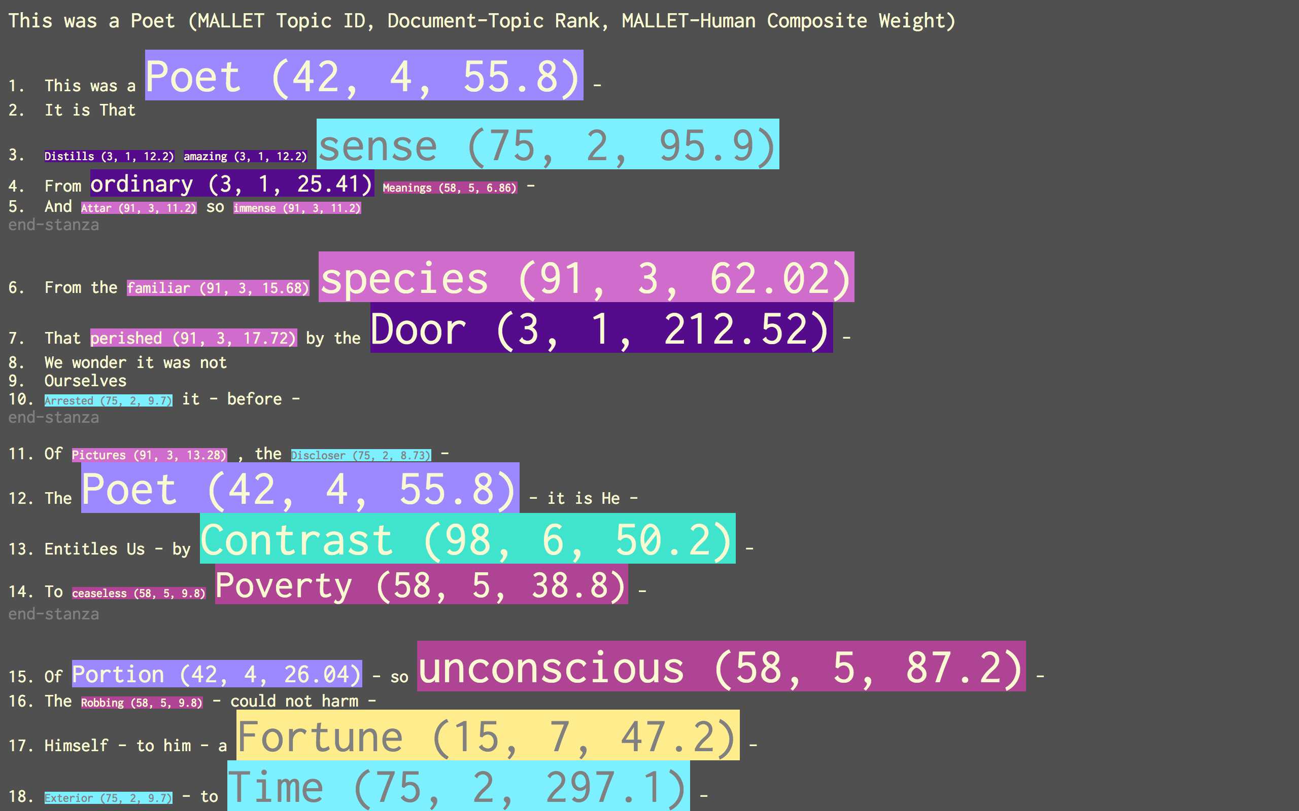
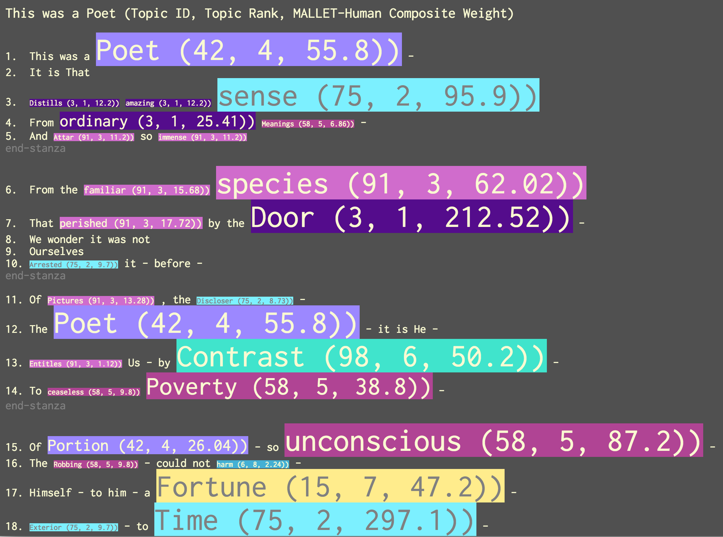

Slide 40
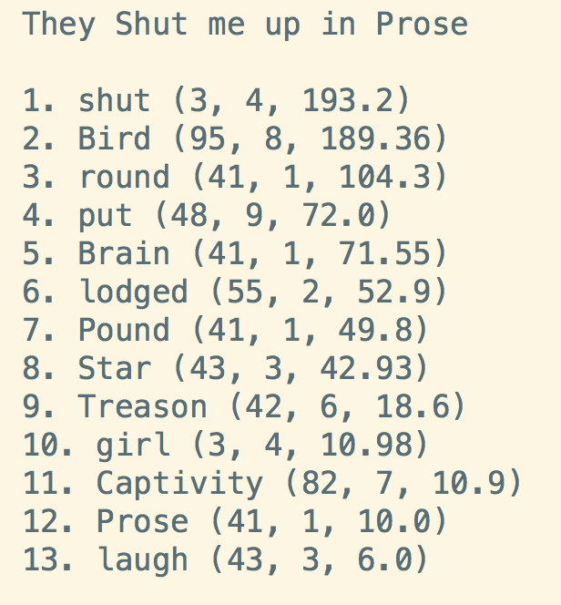
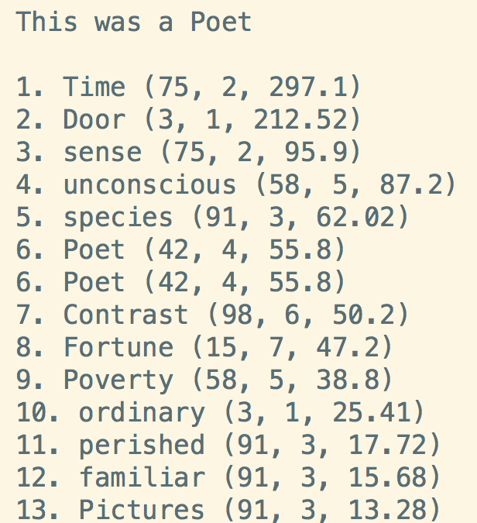
Both the topic model and Heginbotham contribute to a new, supplementary reading,
this via the individual contexts of these words & their relationships among Emily Dickinson’s fascicles and poems

Slide 41
TWiC Close Reading
github.com/jarmoza/twic_close_reading
Features: (1) Individual, interactive HTML file per text with: a. Highlighting of words from the same topic via mouseover b. Topic model metadata for document-topic, topic word weight, and a composite weight of both c. A list of topic words in the text ranked via that all three of those weights (2) JSON file per text including all that collated topic model data
(feature available in next release)

Slide 42
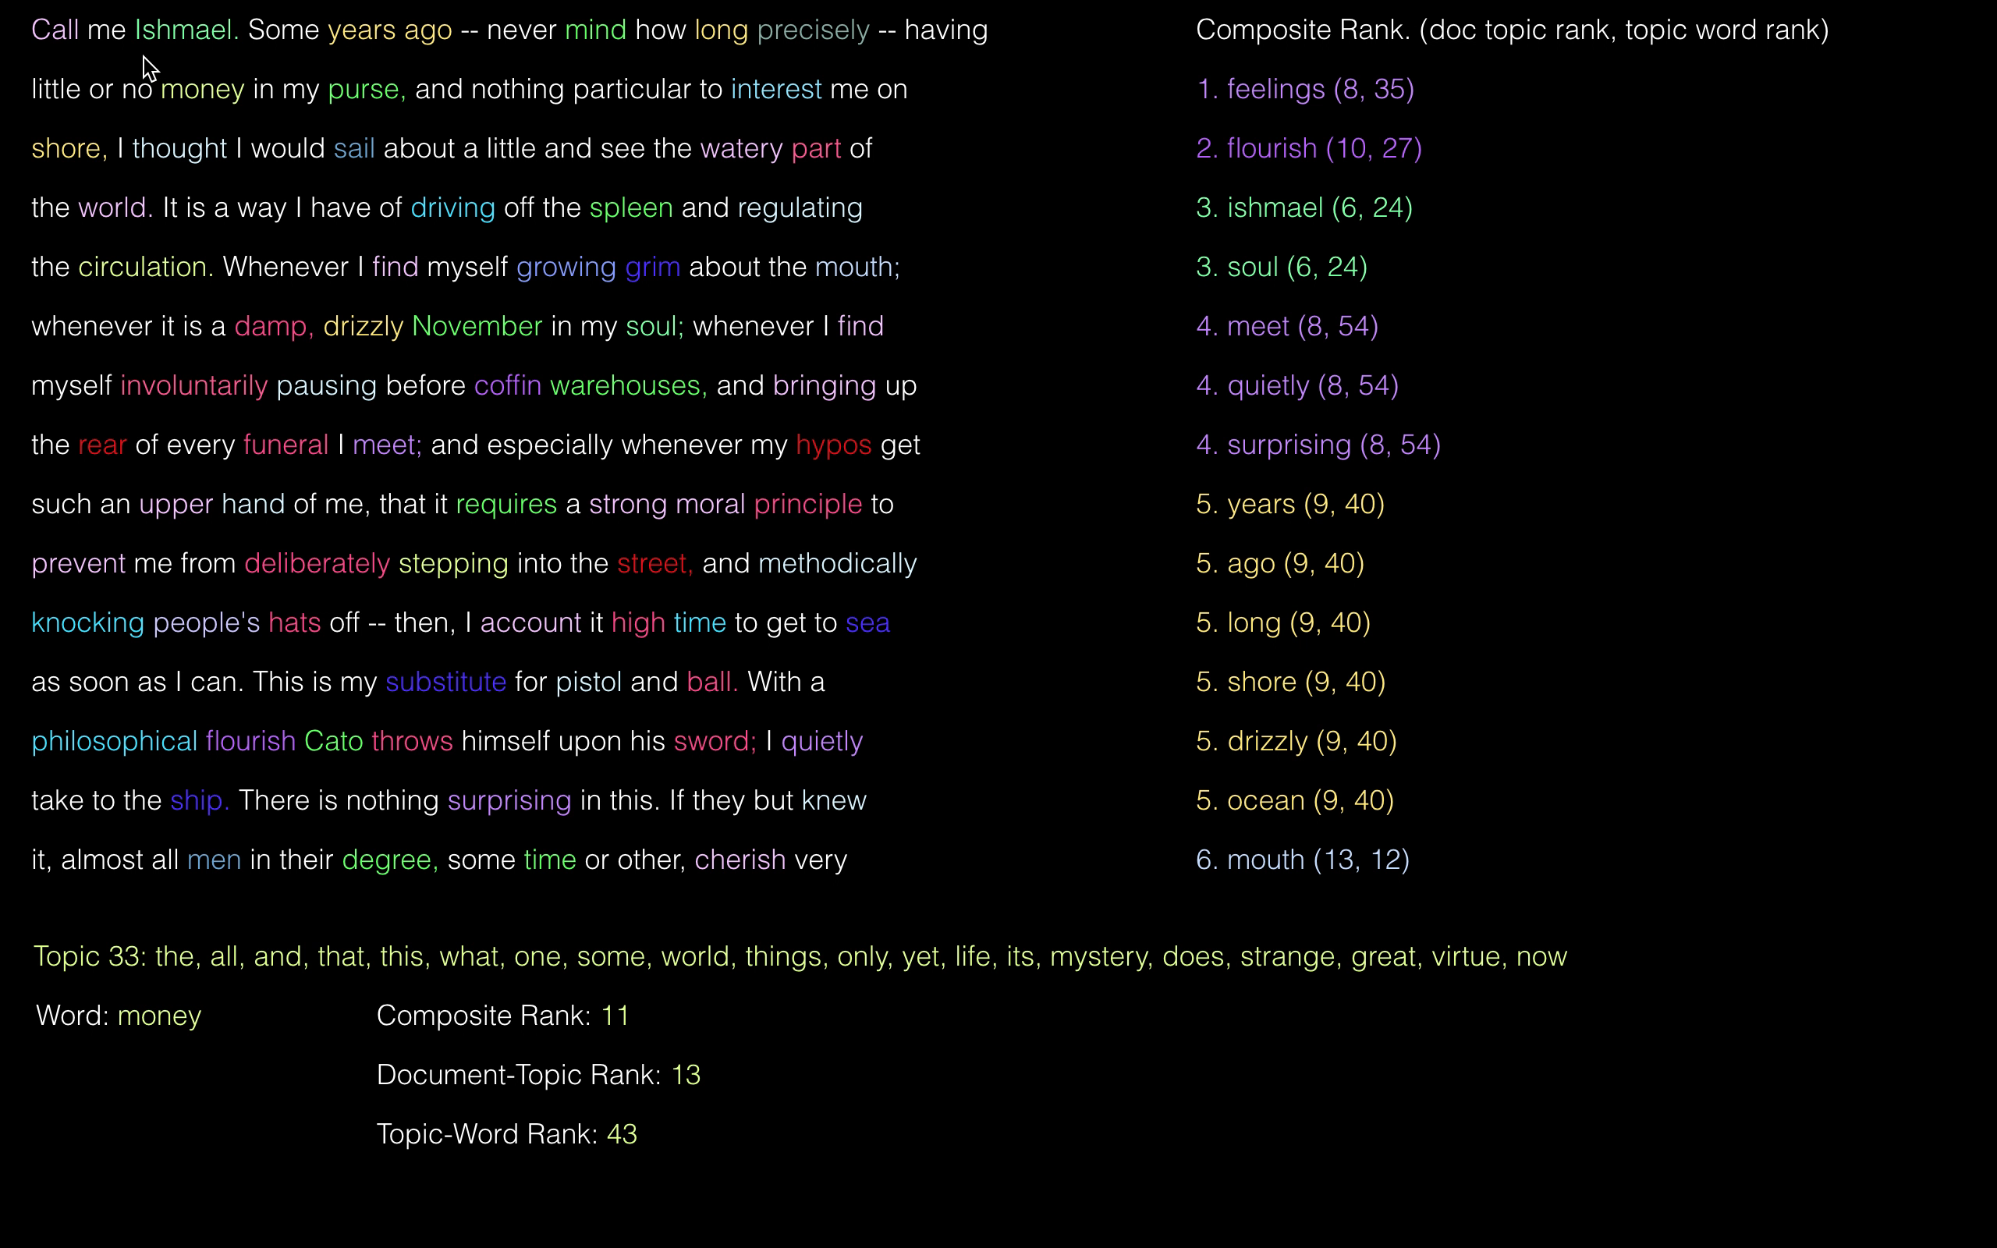

Slide 43

Thanks!
Technology
MALLET (Modeling): mallet.cs.umass.edu
plotly (Graphs): plot.ly
Python (Sublime & Elbow grease): python.org
D3 (Visualization magic): d3js.org
Special Thanks
Stéfan Sinclair, Peter Gibian, Matt Milner,
David Blei, David Mimno, Miranda Hickman,
Lev Manovich, Tom Augst, Deena Engel, Marion Thain
: @jonathangrams
: github.com/jarmoza

